Slide 1
The Godhead
Foundations for Life

Slide 2
The Trinity
God is one, yet exists not as two but as three distinct Persons. That is a mystery unparalleled in our experience. No earthly illustration can do justice to the Trinity. His greatness is infinite, and we can never fully comprehend it. We must simply accept the clear teaching of Scripture.
The Trinity is seen in both the Old and New Testaments:

Slide 3
Old Testament Teaching
Gen. 1:1 - The Hebrew word translated God is Elohim. The plural suffix im, presents a singular God who is expressed as a plurality.
Gen. 1:26 - The plurality of the Godhead is also evident in creation - “let us make man, in our image.”

Slide 4
New Testament Teaching
Luke 1:35 - All members of the Trinity were involved in Christ’s incarnation.
Matt. 3:17 - The Trinity was present at Christ’s baptism.
The Trinity was involved in the resurrection of Christ.
  The Father - Rom. 6:4; Gal. 1:1; I Pet. 1:3
  The Son - John 10:18
  The Holy Spirit - Rom . 8:1
Let’s look at each part of the Trinity

Slide 5
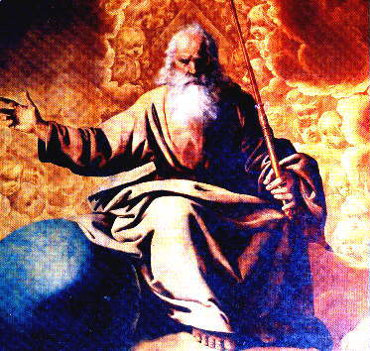
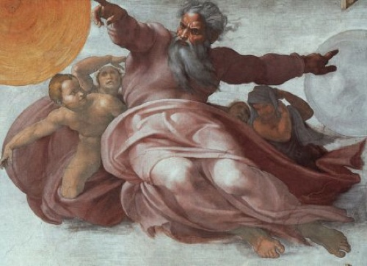
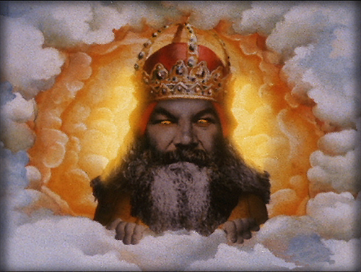
God the Father

Slide 6
God is Sovereign
The word “sovereignty” simply means, “supreme power, or freedom from external control”.
He does what He pleases both in heaven and earth to accomplish His purposes.
There is no power or authority greater than God to whom He must submit Himself.
I Cor. 8:6 - tells us that God is the ultimate source and the ultimate destiny of all things. In Greek the words “all things” signify the totality of things without any exclusion.

Slide 7
God is Sovereign
God has made everything in all His creation and all things are under His sovereign control.
Isa 46:9-10: God accomplishes the things that He sets out to accomplish. Nothing can frustrate the timing and purpose of God

Slide 8
Discussion Question
Is there anything that is not under the direct control and authority of God?
What happens when I miss a turn on the turnpike?
What about storms and earthquakes?
Can I do something that God doesn’t want to happen?

Slide 9
God Sustains
What God creates He also sustains, maintains, and preserves.
He “upholds all things by the word of His power” (Heb. 1:3). The Greek word for “uphold” means “to support” or “maintain.” It is used in the present tense, implying continuous action.
This is much more than a law of nature; it is the very activity of God. If God ceased to be sovereign in creation, we would cease to exist.

Slide 10
Discussion Question
What are some of the views about how God “operates” in the world?
Watchmaker
Meddler
Disinterested Observer
Model Train Enthusiast

Slide 11
God Chooses
God sovereignly exercises His option as creator of all to select certain individuals to receive His divine mercy. There are three theological senses in which He chooses or elects.

Slide 12
Theocratic Election
Theocratic Election refers to God’s selection of a nation to be His covenant people - Deut. 7:6; 9:6.
God freely chose them out of His love and grace, not because of any merit on their part.

Slide 13
Vocational Election
Vocational Election: God sometimes chooses particular individuals to do specific tasks
God chose Moses to lead Israel from Egypt,
God chose Levites to serve the nation as the priestly tribe
Christ chose twelve of His followers to be apostles.

Slide 14
Salvational Election
Salvational Election: God selects people for salvation - I Pet. 1:1-2; Eph. 1:4.
God formed the body of Christ by His independent, sovereign choice.
His choice was totally apart from any human consideration and purely on the basis of His own will - Eph. 1:5, 11.

Slide 15
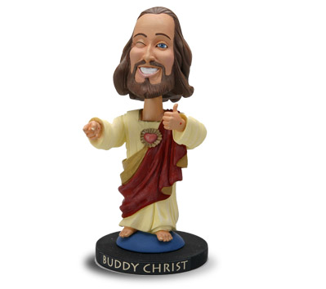
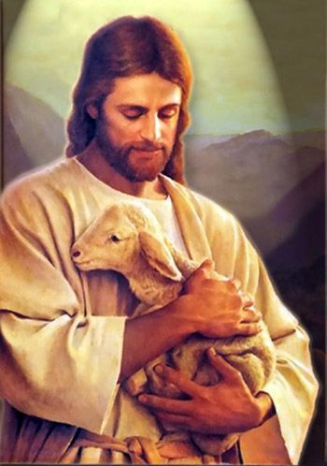
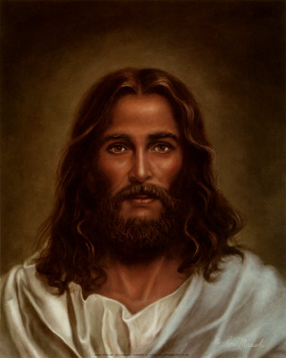
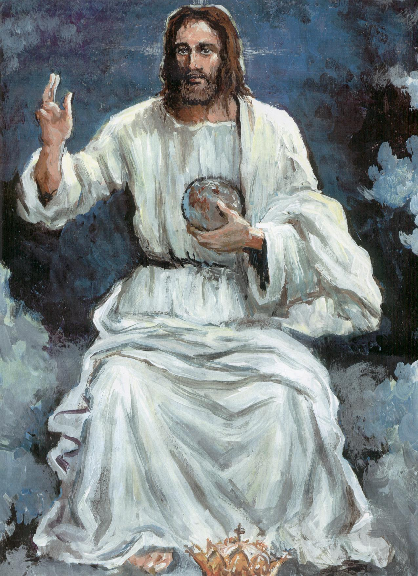
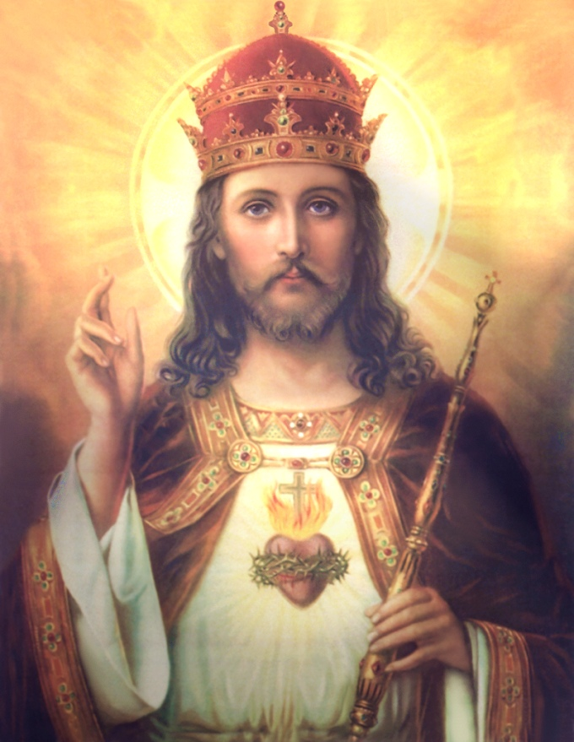
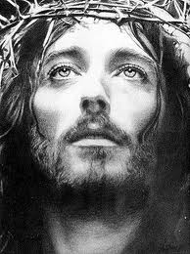
God the Son

Slide 16
Characteristics of Christ
Isa 9:6-7 - Christ’s Deity asserted along with Father and Spirit. Called Mighty God, Eternal Father
Heb 1:8 – Christ is Eternal
John 1:3 – Christ as Creator
Col 2:2-3 – Christ is all-knowing
Jesus is equal to God the Father (Col 1:15-17) Some false teachers hold He is a lesser being.

Slide 17
Jesus was fully man and fully God
Virgin birth critically important
Established the deity of Christ. He received no fallen nature from his earthly father.
No doubt as to divine nature. Apart from man’s normal process of childbirth
Made possible the humanity of Christ. Deity was not diminished – did not surrender any attributes. Never ceased being God.

Slide 18
Jesus Paid the Debt
Rom 8:1 – believer set free from bondage
Rom 3:25 – Christ was the only suitable payment and so He gave himself a ransom for all. (1 Tim 2:6)
Rom 5:8-9 – We are no longer children of wrath
Jesus delivered us from “wrath to come”
1 Thess 1:10

Slide 19
Jesus was Raised from the Dead
Made several appearances over 40 days
Angels told disciples he would come again
We still await His return

Slide 20
Jesus Will Return to Earth
In the time prophesied by Daniel as the 70th week, Christ will return and pour out judgment on unbelievers.
Following the 70th week, Christ returns to establish His millennial kingdom

Slide 21
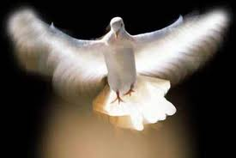

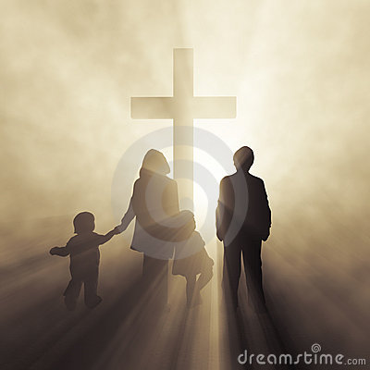
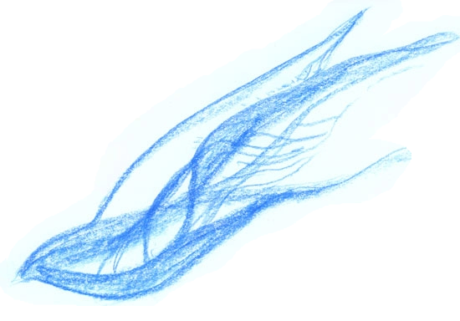
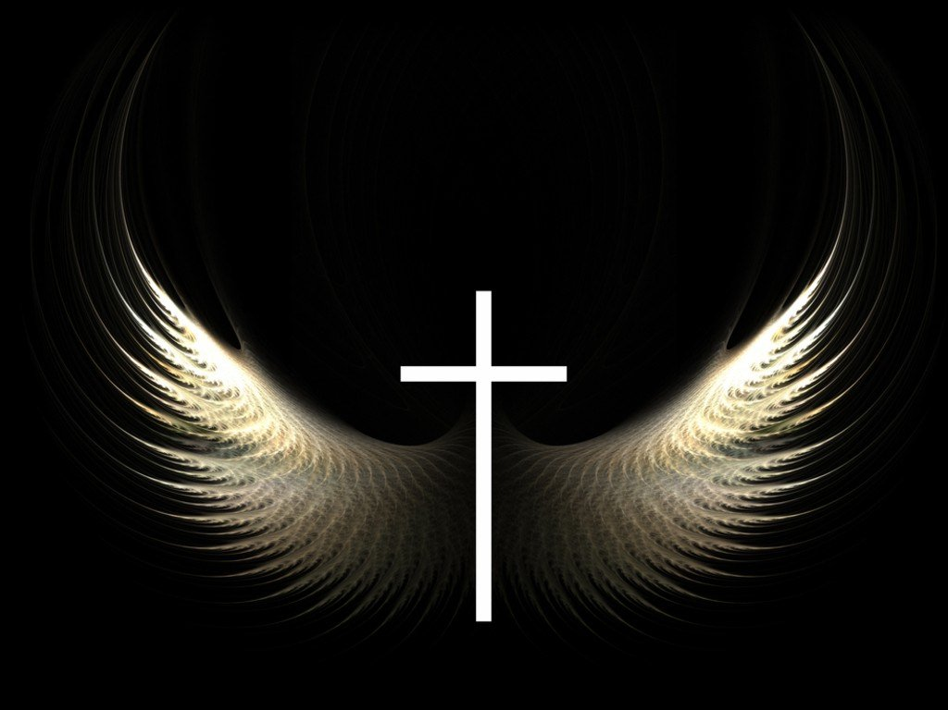

God the Holy Spirit

Slide 22
God the Holy Spirit
By the deity of the Holy Spirit is meant that He is one with God, and one in the Godhead, coequal, coeternal, and consubstantial with the Father and the Son. Scripture teaches us that He is indeed God by both His attributes and His associations.

Slide 23
Functions of the Holy Spirit
His activity as advocate and prosecutor.
John 16:8-11
The Spirit is the “advocate” or helper of those who believe in Jesus, their counsel for the defense.
In relation to unbelievers and to the godless world, He acts as counsel for the prosecution- expressed by the verb, “elencho,” meaning to expose, refute, convince, or convict.

Slide 24
Functions of the Holy Spirit
His activity in creation. Gen. 1:2
The work of creation is generally ascribed to God without distinguishing the persons within the Godhead. In this verse we learn that the Holy Spirit did play an active role in creation.
The use of the word Elohim also indicates His involvement in creation.

Slide 25
Functions of the Holy Spirit
His activity in the incarnation. Matt. 1:18
The Holy Spirit was the agent of the virgin birth. It was through Him that conception took place.
The Holy Spirit’s involvement in the birth of Christ was made known to Mary - Luke 1:35 and Joseph - Matt. 1:20.

Slide 26
Functions of the Holy Spirit
His activity in inspiration. II Pet. 1:20-21
Although the scriptures were breathed out from God (II Tim. 3:16), the particular person of the Godhead who bore along the human authors was the Holy Spirit.
The result of this divine-human effort was the inspired text of the bible.

Slide 27
Functions of the Holy Spirit
His activity in salvation. John 3:5-7
The cleansing work of the Holy Spirit is absolutely essential to salvation. When a sinner comes to Christ, he is regenerated, or born-again.
He is cleansed of his sin through the regenerating ministry of the Holy Spirit - Titus 3:5.

Slide 28
Ministries of the Holy Spirit
Regeneration - Divine regeneration means the impartation of a life from God which is wholly foreign to that of fallen man.
It is the divine nature. It is “Christ in you, the hope of glory” (Col. 1:27).
This work of regeneration takes place at salvation - Eph. 2:5

Slide 29
Ministries of the Holy Spirit
Baptism – The word comes from the Greek “baptizo” meaning to be enveloped with an element becoming subject to that element.
Spirit’s Baptism means to be permanently joined to the Lord.
Like regeneration, it happens only once, at the moment of salvation. 1 Cor 12:13
Not possible to be a Christian and NOT be baptized with the Holy Spirit.

Slide 30
Ministries of the Holy Spirit
Also not possible to have more than one baptism.
The Holy Spirit baptized believer is forever sealed as a member of the body of Christ

Slide 31
Ministries of the Holy Spirit
Indwelling – At the moment of salvation, the Holy Spirit indwells or lives in the believer. John 1:37-39
Believer thereafter is the temple of God
1 Cor 6:19-20

Slide 32
Ministries of the Holy Spirit
Sanctification – meaning to be set apart for a special purpose and particular end.
Positional sanctification is the setting apart which occurs when, by the Holy Spirit, the one who believes is joined unto Christ and thus comes to be in Christ - see Heb. 10:14-15.

Slide 33
Ministries of the Holy Spirit
Progressive sanctification is a maturing in Christ only possible through the work of the Spirit - II Cor. 3:18.
Unlike positional sanctification, progressive sanctification is a life-long process which will not be complete until the believer reaches heaven.

Slide 34
Ministries of the Holy Spirit
Instructs - The Holy Spirit is the Master Teacher, but spiritually this ministry is restricted to the Word of God.
The Word of God is only understood through the personal illumination of the Holy Spirit - John 16:12-15; I Cor. 2:9-12.
Empowers - The Spirit is given to the believer to empower him for ministry - see Acts 1:8.

Slide 35
Ministries of the Holy Spirit
Sealing - The presence of the Holy Spirit within the believer serves as a mark of divine discrimination –
II Tim. 2:19.
Sealing belongs to those who are justified and perfected forever in Christ - sealing indicates security. The one who seals becomes responsible for the object upon which the seal is imposed - II Cor. 1:22; Eph. 4:30.
Eph. 1:13 - This verse states that the believer is sealed with the Holy Spirit which identifies him as belonging to Christ and which guarantees the believers experience in heaven.

Slide 36
Filled with the Spirit
To be filled with the Spirit involves a day-by-day, moment-by-moment submission to the Spirit’s control.
The filling is entirely the work of the Spirit Himself, but He works only through our willing submission.

Slide 37
Filled with the Spirit
To be filled with the Spirit involves confession of sin, surrender of will, intellect, body, time, talent, possessions, and desires.
It requires the death of selfishness and the slaying of self-will. When we die to self, the Lord fills with His Spirit.

Slide 38
P/E or Homework
Some believe that a trinity is really three different Gods. How do you defend the Trinity with Scripture?
Some believe that God created Jesus and the Spirit and that they work on His behalf. Explain the fallacy of this belief.
Which element of the Trinity is the most powerful?

