Slide 1
The Angels and Satan
Foundations for Life

Slide 2
Angels
What do they look like?
What do they do?
What are their powers?
Do we become angels?
What are the popular thoughts about Angels?

Slide 3


Slide 4
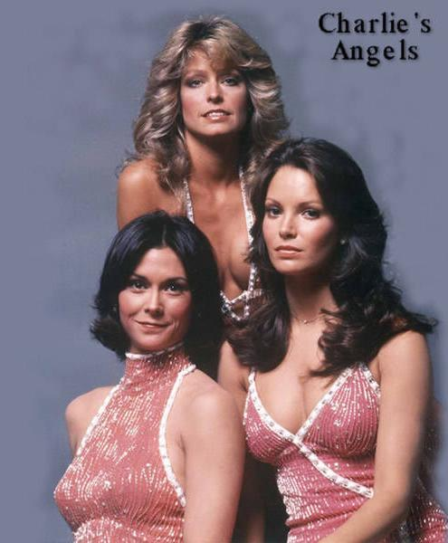
Talk About Angels
Not what Angels look like??
Perhaps this next slide will
make you more comfortable

Slide 5
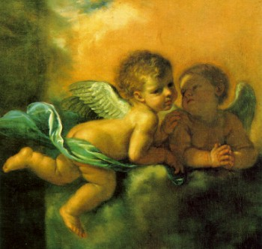
Talk About Angels
Who Created Them?
  Psalm 148:2-5
  John 1:1-3
How Were They Created?
  Refer again to Psalm 148:5
  Do they procreate as do humans? Matt 22:28-30
  Gen 6:2,4 Jude 6:7
  When were they created? Job 38:7

Slide 6
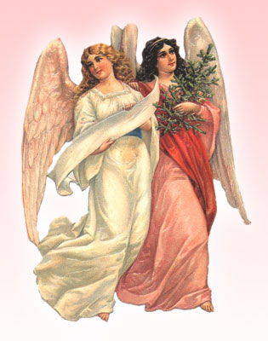
Origin of Angels
Why were they created?
  Glorify God and His Christ Col 1:16
  Reflect the creative wisdom of God
  Worship and serve God in the administration of His will Heb 1:6,7
  Execute His commands

Slide 7
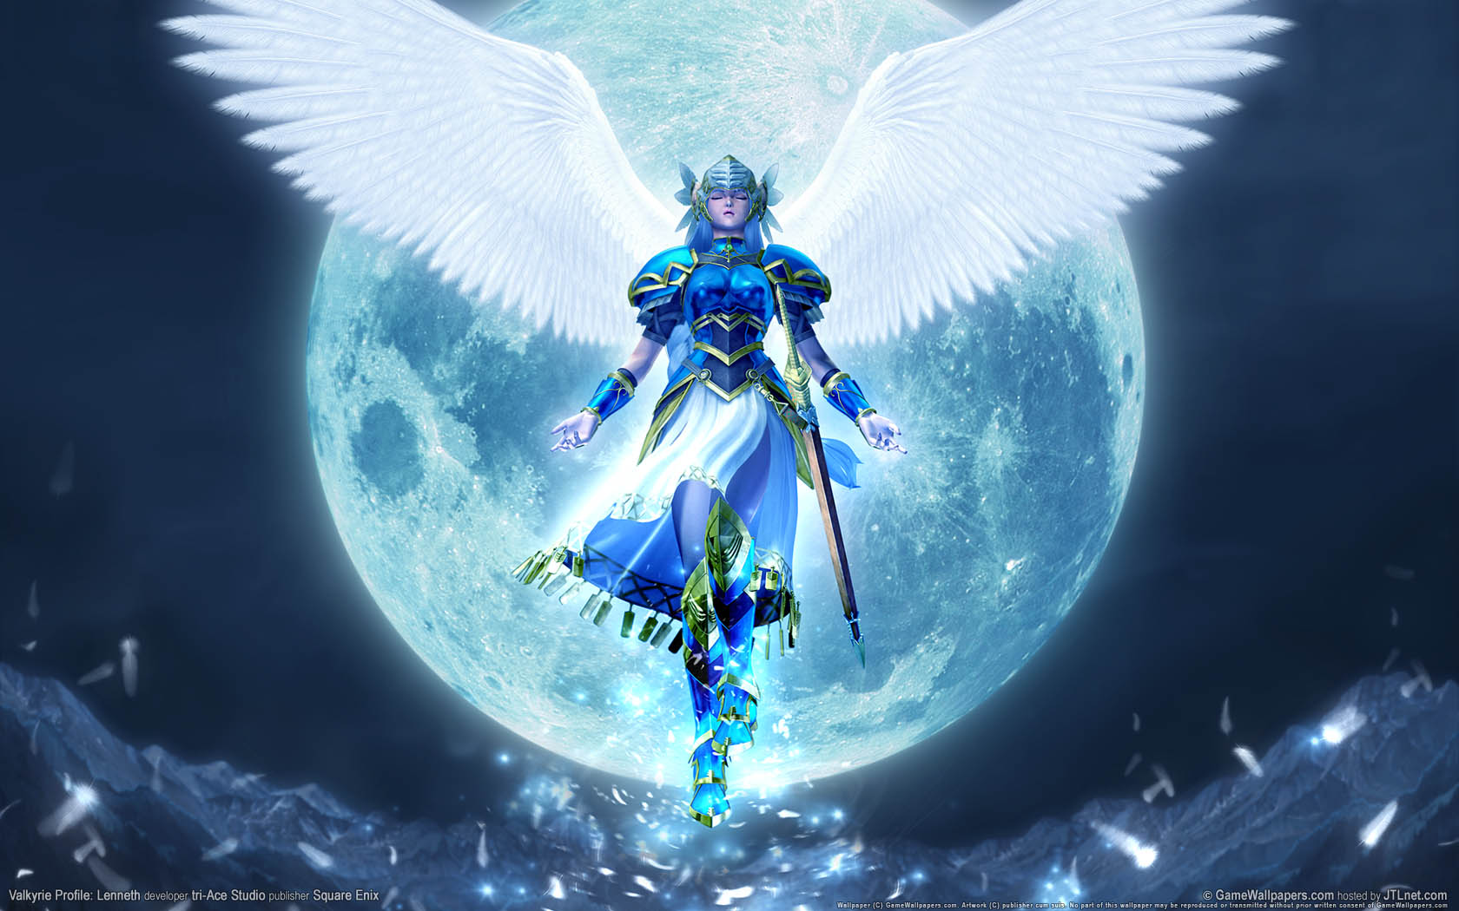
Original Condition of Angels
Holy State
  Considered “Holy” Mark 8:38
  Existed among every good and holy thing Matt 18:10
  2 Classes of Angels now –
    elect 1 Tim 5:21
    evil Matt 25:41
  Ranks of Angels
    Seraphim Isaiah 6:2
    Cherubim Gen 3:24
    Archangel Jude 1:9
    Guardian? Mat 18:10
    Thrones, Rulers,
    Virtues, Powers, Principalities (Eph 6:12, Col 1:16)

Slide 8
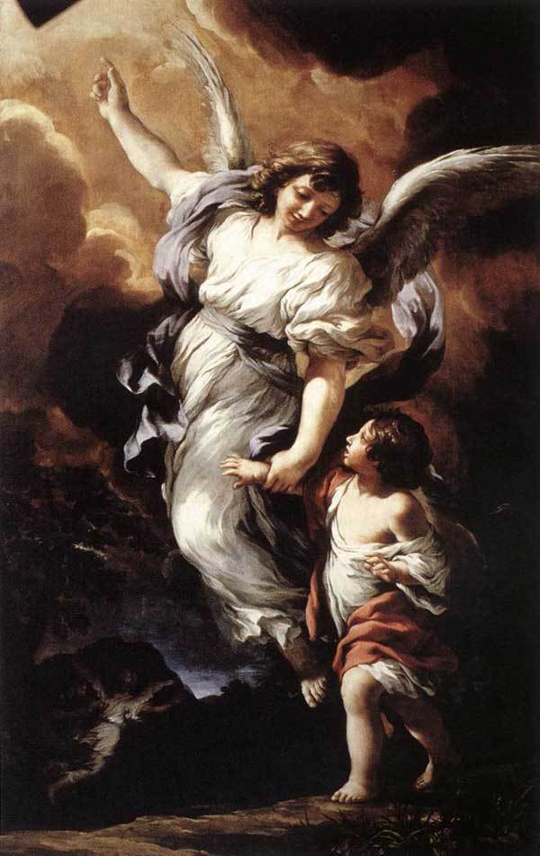
Original Condition of Angels
They are in Daily Communion with God
Limitations
  Space Dan 9:21
  Power
    Greater than man 2 Pet 2:11
    Over nature Rev 7:1
    Limited in Authority Job 1:12
  Intellect - not omniscient 1 Pet 1:11-12
  Holiness – Some did fall -

Slide 9
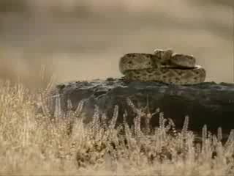

Slide 10
Ministry of Angels - God
Worship Isaiah 6:3
  Ascribe worthiness and grace to God and Christ
  Rev 5:8-13
  Sing Praise
Service
  Priestly Ministers – Heb 1:7
    Not to be worshipped by man (Col 2:18)
  Personal Messengers –
    Angel means Messenger in Hebrew and Greek
    Gabriel – news to Zacharias and to Mary

Slide 11

Ministry of Angels - Believers
Revealing
  Revelation of Law to Moses Acts 7
  Interpreting visions Zech 4:1
  Predicting birth of John the Baptist Luke 1
  Birth of Christ to Mary and Joseph Matt 1
Guiding
  Instruction to Joseph about Mary Matt 1
  Women who came to the tomb
  Philip to a particular road to meet Ethiopian Acts 8
  Cornelius to send for Peter

Slide 12
Ministry of Angels - Believers
Providing
  Encouraged Hagar Gen 21
  God’s provision of manna – Angel’s food Psalm 78
  Comforted Elijah 1 Kings 19
Protecting
  Jacob protected in travels Gen 32
  Daniel with the Lion Dan 6
  Elisha at Dothan – protected with an ARMY of angels 2 Kings 6:13-17

Slide 13
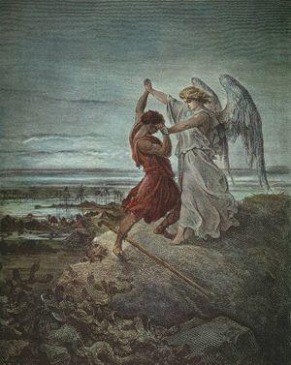
Ministry of Angels - Believers
Delivering
  Safeguarding 144,000 Israelites in Rev 7
  Apostles removed from prison Acts 5
  Peter’s chains removed Acts 12
Strengthening and Encouraging
  Christ in Matt 4
  Paul in the storm at sea Acts 27

Slide 14
Ministry of Angels - Believers
Agent in answering prayer
  Gabriel sent to Daniel regarding Israel in Dan 9
  Delivery of Peter from Prison in Acts 12
Attendants upon the righteous dead
  Carried Lazarus’ spirit to Abrahams bosom
  Luke 16
  Moses’ body in dispute with Satan for archangel Michael in Jude 1:9

Slide 15
Ministry of Angels - Believers
Ministry to men is primarily external and physical
Holy Spirit ministry is primarily internal and spiritual
Angels minister FOR us, Spirit ministers IN us
Angels guard our bodies and pathway – Spirit guides us in the right way
Agents to answer prayer, Spirit directs our prayers.

Slide 16
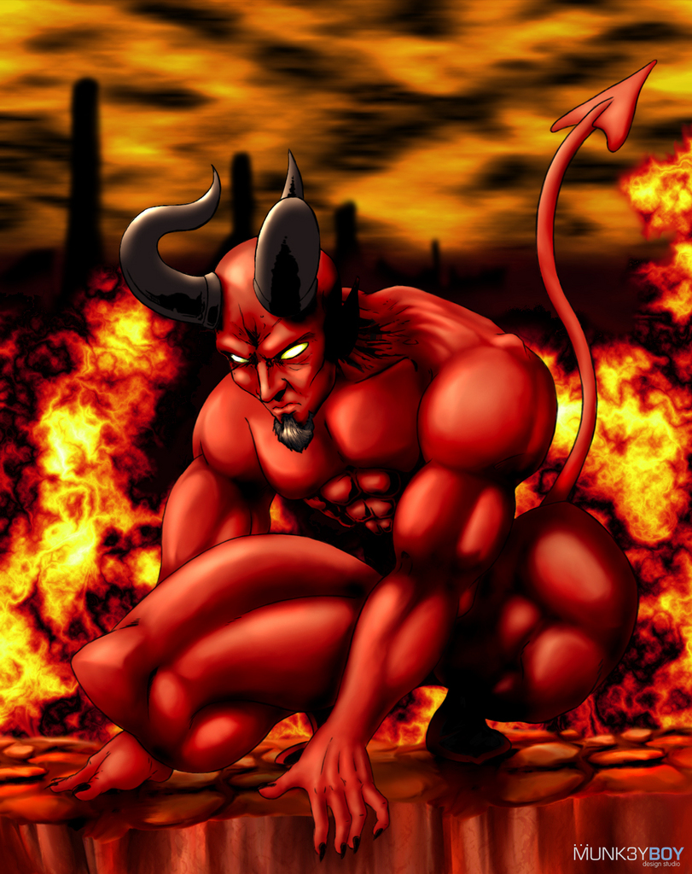
Fallen Angels
What does Satan look like?
What is his job?
What are his abilities?
What are his limitations?
We must use scripture to determine our view, not Hollywood!

Slide 17


Slide 18
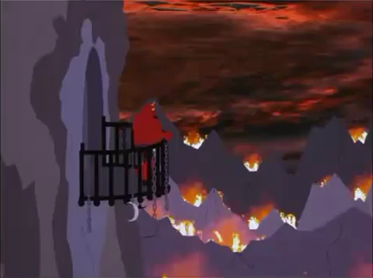

Slide 19
Original State and Fall of Satan
Primary sin – Rebellion 1 Tim 3:6
How many fell with him? Rev 12:4
Privileges Ezekiel 28
  Nature – Cherub - v.14, greatest v.13
  Position - Twice called a guardian cherub
  Habitation – Eden v. 13,mountain of God v.14
  Perfection – seal of perfection v.12

Slide 20
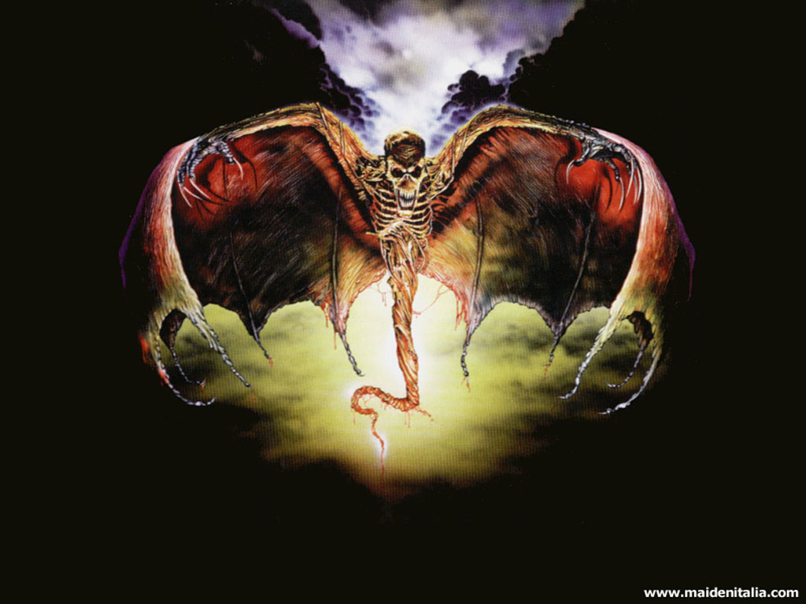
Original State and Fall of Satan
How did he become evil?
  No explanation – iniquity found in thee v. 15
  Proud and self-occupation Isaiah 14:12-17
Punishment
  Cast from privileged position v. 16
  Ultimately he will be cast in
  the lake of fire

Slide 21
Present Power and Activity of Satan
Relation to God
  Opposes God’s person – because he desires to be the most high, he is against God. He uses man to attack character and control of God.
  Opposes God’s program – promotes “the lie”
    Evolution for creation
    Uniformitarianism for providence
    Human progress for divine salvation
    Man’s utopia for God’s kingdom
    Atheism, agnosticism, pragmatism and relativism for truth

Slide 22
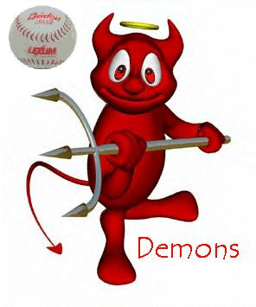
Present Power and Activity of Satan
  Promotes counterfeit religions
    False ministers 2 Cor 11:13-15
    Controls works of God Gal 1:6
  Promotes false doctrines
    Works righteousness 1 Tim 4:1-3
    Self seeking 2 Pet 2:1
  False Christs - 1 John 2:18
  False Followers – Matt 13:38-39

Slide 23
Present Power and Activity of Satan
Relation to Unsaved
  Prevent acceptance of truth
    Snatch away the gospel Luke 8:12 prevents understanding
    Blinding minds 2 Cor 4:3-4 creates barrier and makes gospel seem irrelevant
  Promote attraction to falsehood
    False Religions – 1 Tim 4:1-3
      Salvation by human works – attractive to those who desire to bypass Savior’s work – no need for salvation. Many seek human progress or life in the spirit world – mysticism.
    False Lifestyle – Pleasure, possessions and position 1 John 2:15-17

Slide 24
Present Power and Activity of Satan
In relation to Christians
  Waging warfare Eph 6:10-18
  Accusing and slandering Rev 12:10 Satan is accusing us before God. Jesus is the Defense!
  Planting doubt Gen 3:1-5 Emphasize God is restrictive, selfish.
  Tempt to Sin
    Lie, Sex, occupation with world, rely on human wisdom, spiritual pride, discouragement.

Slide 25
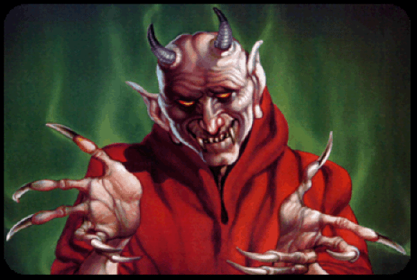
Present Power and Activity of Satan
  Preventing service 1 Thess 2:18 Paul hindered
  Promote division 2 Cor 2:10-11

Slide 26


Slide 27
Summation
Satan is real! Strives to attack the person and work of God. He is ultimately held in check by the power of God.
Do not overemphasize the power of Satan.
We are responsible for our own actions

