Slide 1
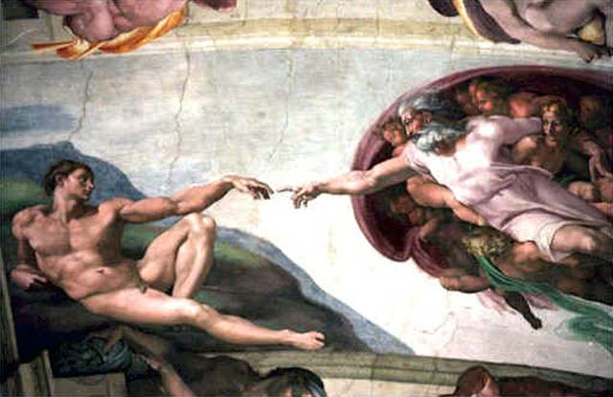
Creation and The Creation and Fall of Man
Foundations for Life

Slide 2
The Creation of the Earth
Scripture does not define this clearly
Gen 1:1-3 contains the record
We know that God was the creator
We know that Man is the focus of His creation
Several views of the creation event

Slide 3
Views of Creation
Historic Creation – God created world, then waited, then continued.
Young-Earth Creation – 6 24-hour days
Gap Theory – Created, destroyed, then rebuilt later.
Day-Age Theory – Days represent ages
Theistic Evolution – God started the process, then allowed natural process

Slide 4
Views of Creation
Problem for most is to account for scientific findings
Safest to stick with the natural reading of the text – Young Earth Creation
Recognize that we do not know all that we want, only what God wants us to know.

Slide 5
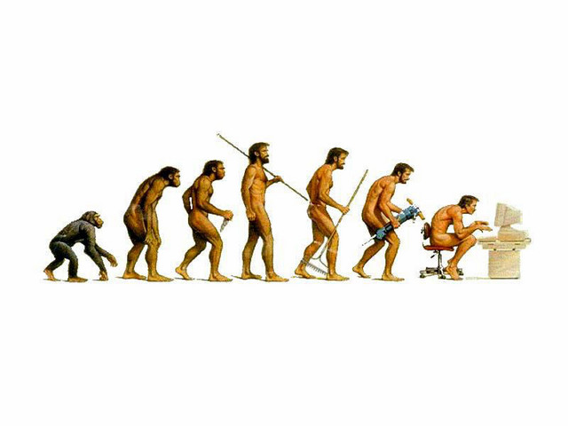
The Creation of Man
How was man created?
  By the immediate, special, creative and formative act of God. Gen 1:26-27, Gen 2:7, 21-22
Not Evolution

Slide 6

Why was Man Created?
To Glorify God
  Isaiah 43:7
  Ephesians 1:11-12
To Enjoy Fellowship with God
  Exodus 29:46
  1 Corinthians 1:9
  1 John 1:3

Slide 7
God Glorifying Fellowship
'God is most glorified in us when we are most satisfied in Him' - John Piper
Throughout the Psalms we see the expressions of a God glorifying Fellowship
In John 17 Jesus’ prayer describes his God glorifying Fellowship

Slide 8
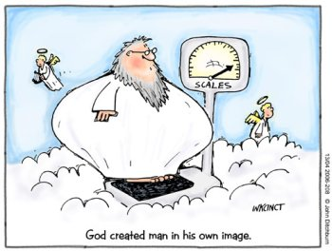

Slide 9
Imago Dei: Image of God
Then God said, "Let us make man in our image, after our likeness.” Genesis 1:26 (Genesis 9:6)
Can be understood: “Let us make man to be like us and to represent us.”
Not physical appearance: God is Spirit
Like God in Capacities and Characteristics (intellectual, moral, etc).
Reinforces the idea that our created purpose is to bring glory to God.

Slide 10
Adam before the Fall
Created in the image of God (Gen 1:26-27)
Abundant Life (Gen 1:7-9)
Sinless (Gen 1:28-31)
Glorified God and Enjoyed Fellowship with Him (Genesis 2:15)
Freedom of choice (Gen 2:16-17)

Slide 11
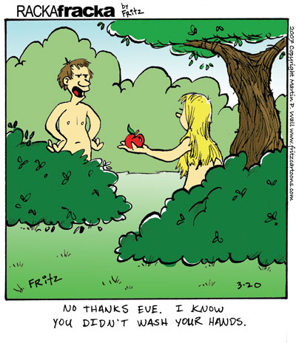

Slide 12
The Fall of Man
Genesis 2:16-17
And the LORD God commanded the man, saying, "You may surely eat of every tree of the garden, but of the tree of the knowledge of good and evil you shall not eat, for in the day that you eat of it you shall surely die."
Genesis 3 tells the story of Adam’s Sin
Romans 5:12-21 explains the implications of Adam’s Sin for all mankind!

Slide 13
Sin and its Consequences
Passed on from Adam to all his descendents
Adamic nature, inborn sin, original sin, old man
Genesis 4:6-7
The LORD said to Cain, "Why are you angry, and why has your face fallen? If you do well, will you not be accepted? And if you do not do well, sin is crouching at the door. Its desire is for you, but you must rule over it."

Slide 14
Total Depravity
Total: it affects EVERY human being
  it affects every part of our nature
Depravity: without merit in the site of God
  guilty and corrupt/polluted
Does not mean: People are unable to do things that are morally right or good sometimes

Slide 15
Total Depravity
“In our nature, we totally lack Spiritual good before God. In our Actions, we are totally unable to do Spiritual good before God” Wayne Grudem, Systematic Theology
  1 Kings 8:46 – for there is no one who does not sin
  Romans 3:9 – What Then? Are we Jews any better off? No, not at all. For we have already charged that all, both Jews and Greeks, are under sin.
  1 John 1:8 – If we say we have no sin, we deceive ourselves and the truth is not in us.

Slide 16
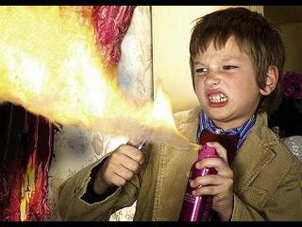

Still not Convinced?
Do you believe now?

Slide 17

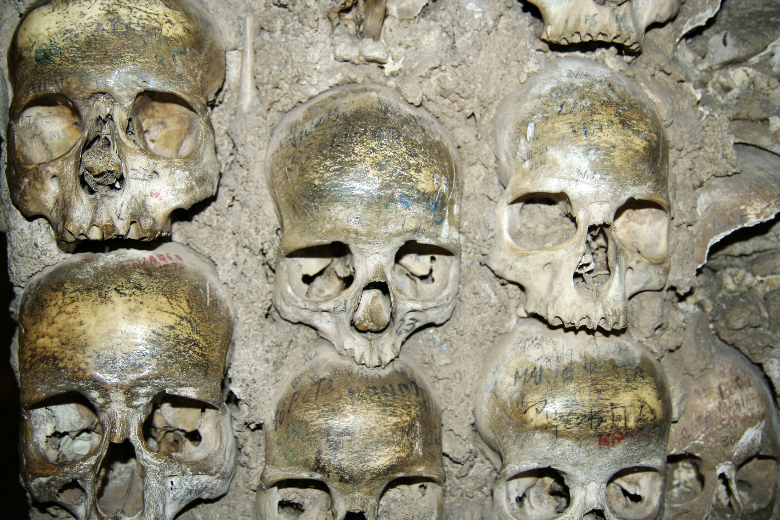
The Deaths of Adam
Spiritual Death and Physical Death

Slide 18
Spiritual Death
Ephesians 2:1-3
And you were dead in the trespasses and sins in which you once walked, following the course of this world, following the prince of the power of the air, the spirit that is now at work in the sons of disobedience— among whom we all once lived in the passions of our flesh, carrying out the desires of the body and the mind, and were by nature children of wrath, like the rest of mankind.

Slide 19
Spiritual Death
Man developed within himself a fallen nature which is contrary to God and is ever prone to evil.
Those in Christ are saved from Spiritual death. Those who die physically and are spiritually dead merge into unending second death.
  “There are two categories of people, those who are under Adam and those who are under Jesus, that’s it.” – Mark Driscoll

Slide 20
Physical Death
Genesis 3:22-24
Then the LORD God said, "Behold, the man has become like one of us in knowing good and evil. Now, lest he reach out his hand and take also of the tree of life and eat, and live forever—" therefore the LORD God sent him out from the garden of Eden to work the ground from which he was taken. He drove out the man, and at the east of the garden of Eden he placed the cherubim and a flaming sword that turned every way to guard the way to the tree of life.

Slide 21
Physical Death
Separation of soul and spirit from the body
One can be alive spiritually and dead physically.
One can also be dead spiritually and alive physically.
In the end, spiritual death in this life, if not healed by redeeming grace, merges into unending second death (1 Cor 15:26)

Slide 22
Activity Part 1
Get in Groups of 7-8
As a group come up with 3 objections people might have to Original Sin and Total Depravity

Slide 23
Activity Part 2
Find at least 3 verses other than the ones already used in the power point to support original sin and total depravity
Use these verses to answer the objections you came up with in part 1

