Slide 1
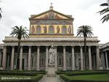

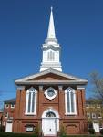
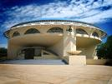
The Church
Foundations
for
Life

Slide 2
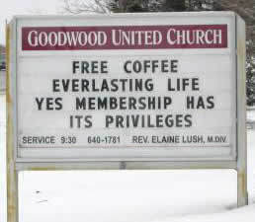
Word “church” refers to:
Local congregation of professing believers
A denominational group
The universal body of true Christian believers
A building used for religious purposes

Slide 3
Origination
Began on day of Pentecost (Acts 2:1-21, 38-47)
Peter proclaimed finished work of Christ
Continues today as evangelism and discipleship take place
Will be complete when Christ returns for His own (Eph 4:13)

Slide 4
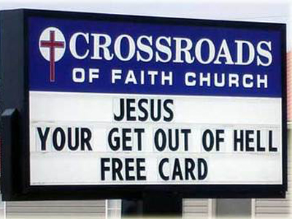
Purpose of Church Today
To be a visible church of those who profess to be Christians.
We become a testimony to the world that Christ has risen

Slide 5
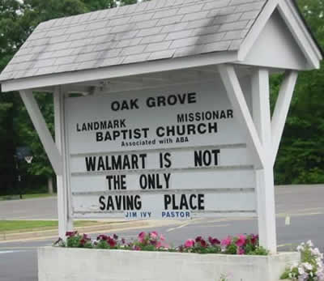
Mission of the Church
To make disciples who will engage in worship, growth, fellowship and service.
The mission to make disciples is carried out through the evangelizing of the lost and the edifying of the saints.

Slide 6
One Definition of Church
Summation of Acts 2:42-47
“The local church is a community of regenerated believers who confess Jesus Christ as Lord. In obedience to scripture, they organize under qualified leadership , gather regularly for preaching and worship, observe the biblical sacraments of baptism and communion, are unified by the Spirit, are disciplined for holiness and scatter to fulfill the Great Commandment and Great Commission as missionaries to the world for God’s glory and their joy.”
Mark Driscoll & Gerry Breshers, Vintage Church

Slide 7
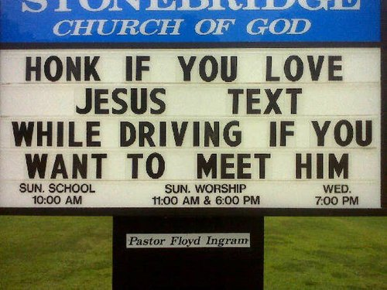
The Basic Task of the Church
To teach sound doctrine. Titus 2:1
The leaders must be faithful to sound doctrine
Churches tend to do many things that distract from the basic task.
Leaders are often drawn
in directions that dissipate
their energies from
this task

Slide 8
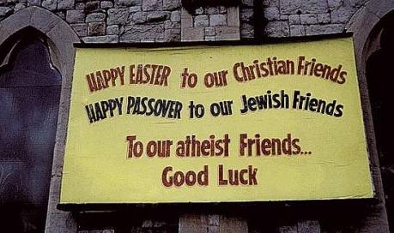
Three forms of Church Government
Episcopal
Presbyterian
Congregational

Slide 9
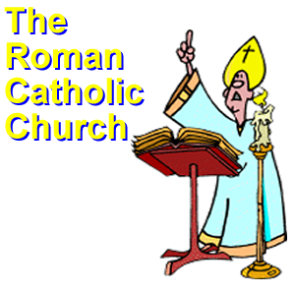
Episcopal
Chief ministers are bishops
Apostles were the supreme leaders of church
They entrusted power to some
That power was succeeded for generations
Church of England (Catholic church) maintains this as well as Lutheran churches
More Christians accept this than any other government.

Slide 10
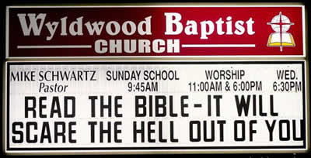
Presbyterian
Importance of elders
John Calvin based Geneva churches on
  Pastor
  Teacher
  Deacon
  Elder
Used throughout
Europe and then
America

Slide 11
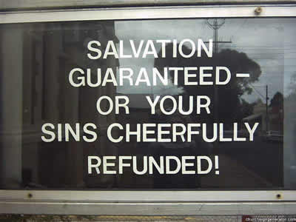
Congregational
Emphasis on congregation
Appeared after the Reformation
Decisions a matter of congregational vote
Developed in Holland, then America (via pilgrims from Leiden in 1620)

Slide 12
Scriptural Support
All forms are implied in Scripture
Only one is fully described and developed
Elder rule (Presbyterian) Hebrews 13:17
Elder and overseer interchangeable
Paul and Barnabas appointed elders (Acts 14:23)
Paul directed Titus to appoint elders (Tit 1:5)

Slide 13
Elders
Highest position of authority 1 Pet 5:2-4
Responsible for Direction, Doctrine, Discipline
1 Tim 3 lists requirements
“Blameless” – no great blot on life
Above reproach as God’s steward
Not self willed, quick tempered, addicted to wine, pugnacious or fond of sordid gain

Slide 14
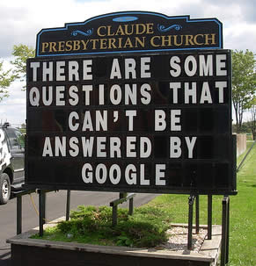
Elders
Must be hospitable v8
Love what is good, sensible, just, devout, self-controlled, holding fast the faithful word v8-9
Elder should know priorities and live by standards of God’s Word.

Slide 15
Deacons
Servants
Collect funds, distribute relief, provide mercy
Help poor, jobless, sick, widowed, elderly, homeless, shut-in, disabled.
Counsel and guide people
Visit people in their homes
Minister to the needs of others in the church

Slide 16
Deacons
Qualifications found in 1 Tim 3:8-13
Personal Character
  Dignity
  Not double-tongued – always righteous in speech
  Not addicted to wine – have clear thinking
  Not fond of sordid gain – can handle money

Slide 17
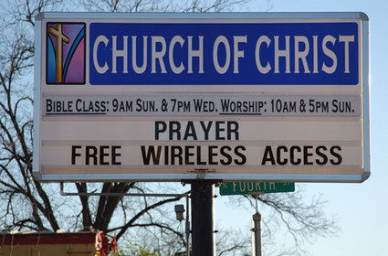
Deacons
Spiritual Character
  Convictions based on knowledge of doctrine
  Must have proved himself faithful in service
  Morally pure – consecrated and devoted to wife
  Leads family well – demonstrate management ability in home with family

Slide 18
Discipline
Applicable only to those who desire to be associated with the church, and is not meant to give license to Church leadership in gray area trivia, but rather the end result should be to purify the Church (I Cor. 5:6-8), to restore an erring person, to deter sin, and to demonstrate the reality of righteous living to the unsaved world.

Slide 19
Sin Often Requiring Discipline
Divisiveness - II Thess. 3:11; Tit. 3:1-11; Rom. 16:17-20.
Unruly, disorderly and undisciplined living - II Thess. 3:6, 11, 14; I Thess. 5:14.
Disruptive conflict between members - I Cor. 6:5; Phil. 4:2-3; Matt. 18:15-18.
Sins of the flesh - I Cor. 5:11; 6:9-10. In particular, but certainly not exclusively, homosexuality (lesbianism) should be addressed in this context. God’s Word is clear that these unnatural relationships must never be tolerated in the church (Rom. 1:26-27).
Public denial of the doctrines of Mosaic Church - I Tim. 6:3; II Tim. 2:16-18; Tit. 3:10; II John 1:10-11; Rev. 2:14.

Slide 20
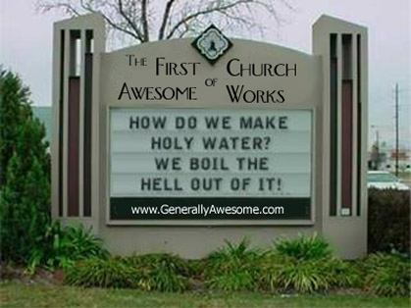
Steps for Church Discipline
First step: Note and mark those who are in need of correction - Rom. 16:17; II Thess. 3:14.
Second step: Arrange a private meeting with the offender - Matt. 18:15. Rebuke him, and if he repents, forgive him
- Luke 17:3.

Slide 21
Steps for Church Discipline
Third step: Set up a second meeting, this time with several others present - Matt. 18:16. During these preliminary private and semiprivate meetings the individual should be repeatedly admonished (Tit. 3:10), rebuked (II Tim. 4:2), and warned (I Thess. 5:14), for the sake of bringing about genuine repentance in the life of the offender. If genuine repentance does occur, the offender should seek the forgiveness from the circle of offense, and no more.

Slide 22
Steps for Church Discipline
Fourth step: As a final resort, the unrepentant one is to be brought before the entire Church - Matt. 18:17; I Tim. 5:20.
Fifth step: Upon refusal to submit to Church discipline the guilty party is to be spiritually excommunicated.
  He is to be denied Christian fellowship:
    II Tim. 3:5, II Thess. 3:6, I Tim. 6:3, 5, Titus 3:10, II Thess. 3:14
  He is to be delivered over to Satan:
    I Cor. 5:5, I Tim. 1:20

Slide 23
Steps for Church Discipline
Upon refusal to heed the warning and correction of the Elder Board and of the Church, he or she shall be publicly dismissed from the Church with the hope of future repentance and reconciliation. There shall be no appeal to any court as a result of this decision (I Cor. 6:1-2)

Slide 24
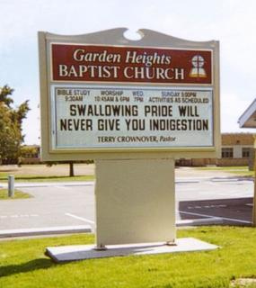
Responsibility of Church Body
In all matters of church discipline, the church congregation is expected, with no exceptions, to keep silent about the matter to any and all outside the
congregation, avoiding the
common sin of “slander”
(II Cor. 12:20).

Slide 25
Ordinances
The word ordinance comes from two Latin words which in their final meaning signify “that which is ordered or commanded.” This term has been used to describe the two institutions:
Baptism
Lord’s Supper

Slide 26
Baptism
Confess identity with Christ to others
As Christ went through death, burial and resurrection, so the Christian emerges from the water dead to sin
Only an illustration of what has taken place in the Believer, baptism has no saving virtue
Baptism is always for the Believer – not for infants. No recorded instance of it.

Slide 27
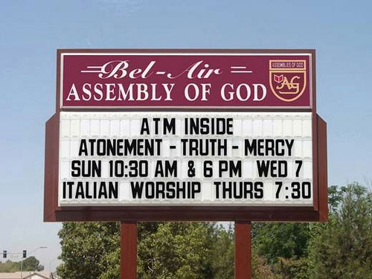
Baptism
Immersion – example set forth in Scripture
Affusion – (sprinkling) not mentioned in Scripture
Given to the church
by Christ, so it is our
responsibility to
participate in it.

Slide 28
The Lord’s Supper
Spiritual experience
Transubstantiation – bread and wine actually become the body and blood
Consubstantiation – body and blood exist alongside the bread and wine
Christ cannot be sacrificed again
First supper, He had not yet been crucified

Slide 29
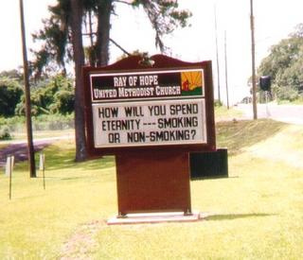
The Lord’s Supper
Instructions found in 1 Cor 1:27-29
Only for those who are Believers
Observe with respect and reverence
Time of heart-searching,
confession and restoration
Early church practiced
frequently
We practice until Christ
returns

Slide 30
Practical Exercise
Write a sign to put out in front of the building of a church you establish.
How would you ensure that you maintain focus in your church as you grow?
What key staff positions would you have in your church – with what duties?
How would you facilitate community in a growing church?

