Slide 1
End Times
Foundations for Life

Slide 2
Overview of the End Times
The seven-year period, known as the 70th Week of Daniel, begins when Israel signs a peace treaty with the Antichrist. (Dan 9:27)
The first 3½ years of the 70th Week of Daniel are characterized as beginning birth pangs. (Matt 24:8)
The mid-point of the 70th Week of Daniel is marked by the Antichrist declaring himself to be God and demanding worship, what Daniel calls the Abomination of Desolation. (Dan 9:27, Matt 24:15)
The period of time from the mid-point of the 70th Week of Daniel until the rapture is known as the Great Tribulation, a time when the Antichrist seeks to destroy Israel and believers. (Matt 24:21)

Slide 3
Overview of the End Times
The rapture of the church cuts short the wrath of the Antichrist and commences the Day of the Lord. (Matt 24:22)
The Day of the Lord is God’s judgment upon the Antichrist and those who follow him. (Rev 19:20)
The Day of the Lord is climaxed and ended by the battle of Armageddon when God destroys the armies of the earth. (Rev 16:13-16, Rev 19:19-21)
God throws the Antichrist and the false prophet into the lake of fire. (Rev 19:20)

Slide 4
Overview of the End Times
Satan is bound and thrown into a pit. (Rev 20:1-3)
A thousand years pass as Christ reigns over the people on the earth that survived the tribulation. (Rev 20:4)
Satan is released, he attempts to overthrow God, and he is thrown into the lake of fire. (Rev 20:7-10)
The story ends describing a time of eternity with beautiful promises of a Christ-focused life for the elect. (Rev 21)

Slide 5
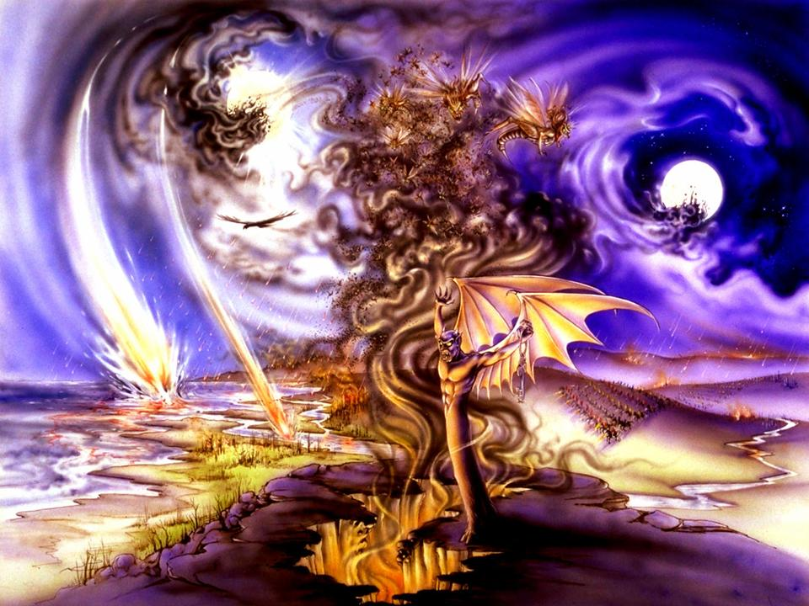
The Tribulation – 70th Week of Daniel
7-year period before the millennium (Kingdom) DAN 9:24-27
Tribulation marked by:
  Man’s rebellion
  Revealing of the Antichrist
  Apostasy of the nation of Israel
  Rapture of the church
  Outpouring of God’s wrath
  Consummation of the “times of
  the Gentiles”
  Spiritual rebirth of the nation of
  Israel
  Destruction of the armies at Armageddon
  Defeat of the Antichrist and Satan

Slide 6
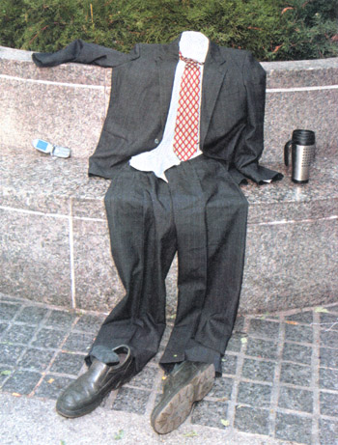
The Rapture – rapid/caught up
Pretribulation Rapture
  True believers raptured before the tribulation
Midtribulation Rapture
  Raptured 3 ½ years into the
  tribulation
Posttribulation Rapture
  Church endures entire tribulation
  – incl God’s wrath

Slide 7
Pre-Wrath Rapture
Rapture sometime during second half of tribulation
  Immediately before the Day of the Lord
  Day of the Lord starts within second half of 70th wk
  Cosmic disturbance with 6th seal signal Day of Lord
  Day of the Lord begin with opening 7th seal Rev 8:1

Slide 8
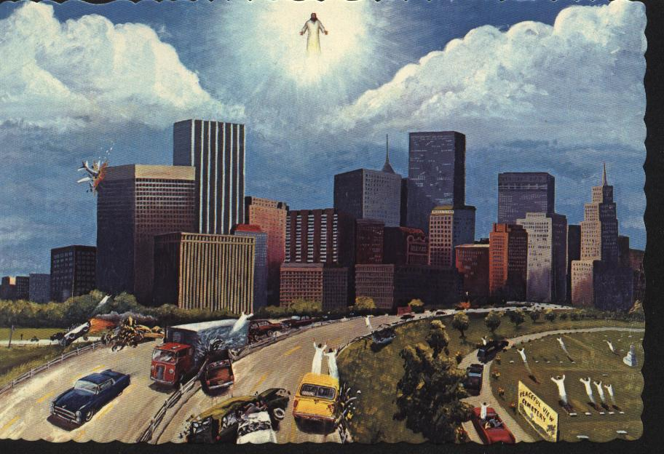

Slide 9
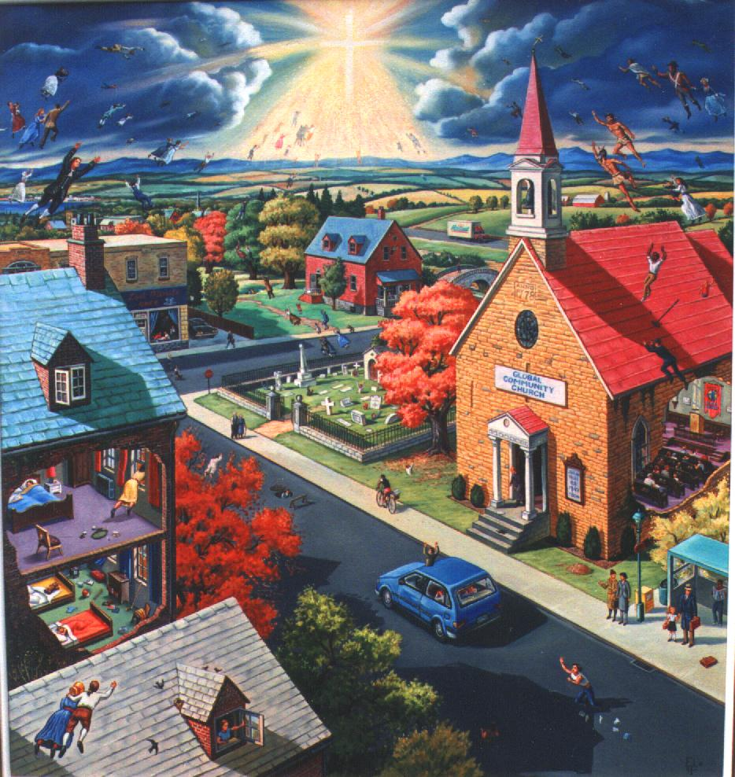

Slide 10
Why PreWrath?

Slide 11
Overview from Daniel
Daniel 9:27:"And he [the "prince who is to come," i.e. the beast or Antichrist, in v. 26] will make a firm covenant with the many for one week, but in the middle of the week he will put a stop to sacrifice and grain offering; and on the wing of abominations will come one who makes desolate, even until a complete destruction, one that is decreed, is poured out on the one who makes desolate.”
Prophetic year is 360 days, so 3 ½ years equals 1260 days

Slide 12
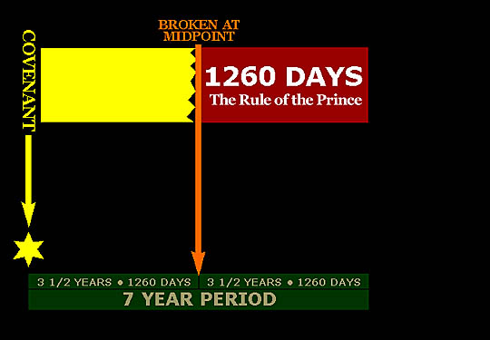
Application of Dan 27

Slide 13
"And from the time that the regular sacrifice is abolished, and the abomination of desolation is set up, there will be 1,290 days." (Dan. 12:11)
This complete destruction of Antichrist will occur at Armageddon (Rev. 19:20-21)

Slide 14
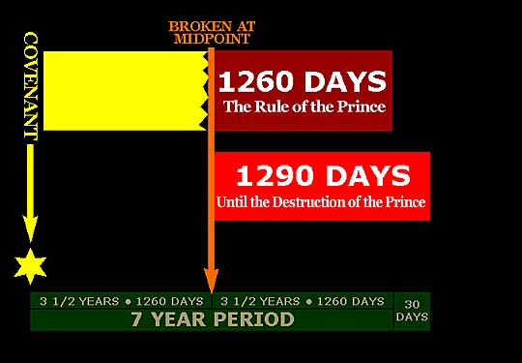

Slide 15
"How blessed is he who keeps waiting and attains to the 1,335 days!" (Dan. 12:12)
The 1,335 days refer to a "blessed" event which, although not explicitly stated as such, can be understood to refer to the beginning of the Millennial Kingdom Rule of Jesus Christ upon the earth – the next event to occur after Armageddon in Revelation 20.

Slide 16
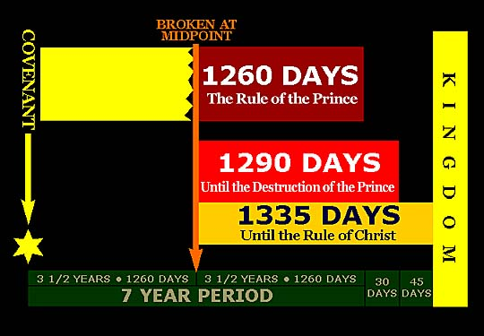

Slide 17
The 1st Seal - The appearance of the false messiah, Antichrist (Rev. 6:1-2; Matt. 24:5)
The 2nd Seal - Wars (Rev. 6:3-4; Matt. 24:6)
The 3rd Seal - Famine (Rev. 6:5-6; Matt. 24:7)
Then in Matthew 24:8, Christ identifies what has transpired, "But all these things are merely the beginning of birth pangs." At that point, Antichrist begins his authority to rule for "forty-two months" (the second half of the seven-year period; Rev. 13:5). Christ calls what will happen next "a great tribulation" (Matt. 24:21).

Slide 18
The 4th Seal - Death, the Great Tribulation of Antichrist (Rev. 6:7-8; Matt. 24:9; Rev. 12:12-17)
The 5th Seal - Cry of those Martyred by Satan's wrath (Rev. 6:9-11; Matt. 24:10, 12; Mark 13:11-12)
The 6th Seal - The signs that initiate the Day of the Lord (Rev. 6:12-14; Matt. 24:29)

Slide 19
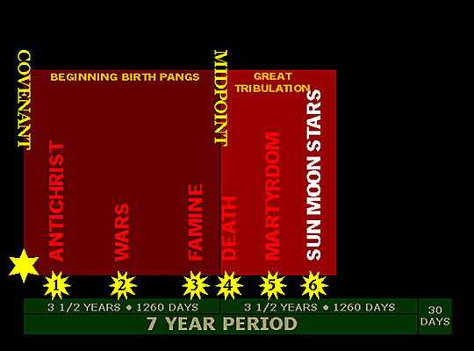

Slide 20
This depiction of when the Rapture will occur does not place the event at a specific time, for no one knows when it will occur (Matt. 24:36). Rather the timing of the Rapture is shown relative to the sequence of events that occur before and after it.
The opening of the 6th Seal results in the signs that initiate the Day of the Lord (Rev. 6:12-14; Matt. 24:29; Joel 2:31 and 3:14-16). This also results in the Great Tribulation being "cut short" (Matt. 24:15, 21-22, 29)

Slide 21
Christ, in the Olivet Discourse, taught that after the sun, moon, and stars go out, "the sign of the Son of Man will appear in the sky,... and He will send forth His angels with a great trumpet and they will gather together His elect from the four winds, from one end of the sky to the other" (Matt. 24:29-31)
The opening of the 7th Seal then initiates the Day of the Lord (Rev. 8:1-6) which is executed through the trumpet and bowl judgments
Paul confirms the sequence thus far in his second epistle to the Thessalonians (2:1-4)

Slide 22
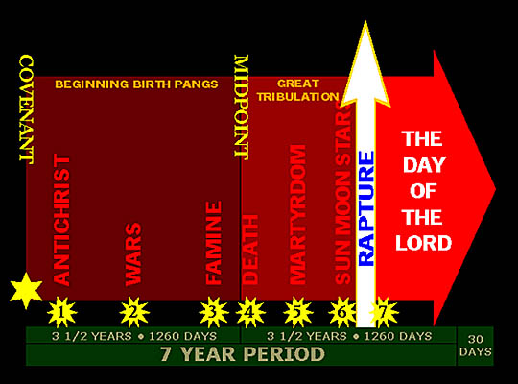

Slide 23
Great Day of the Lord
Synonymous with second coming of Christ
End of Age, final harvest, seventh seal
God’s fiery, judgmental wrath against the earth’s wicked.
Primary purpose: destroy the kingdom of darkness (final beast empire of Satan)
Begins on same day of Rapture – announced with signs in the heavens.

Slide 24
The Great Day of the Lord
Second purpose: refine third part of nation of Israel who survive the great tribulation
Two major parts:
  God’s trumpet judgments against the wicked
  God’s bowl judgments – begin after 70th week
  All ends at the battle of Armageddon

Slide 25
Christ’s Rule During the Millennium
Millennium - Thousand Years
Premillennial View
  Christ returns to the earth before the millenium
Amillennial View
  Between two comings, Christ rules in the heart
Postmillennial
  Man brings in the Kingdom through sharing Gospel. Christ returns after universal acceptance.

Slide 26
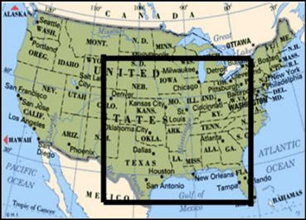
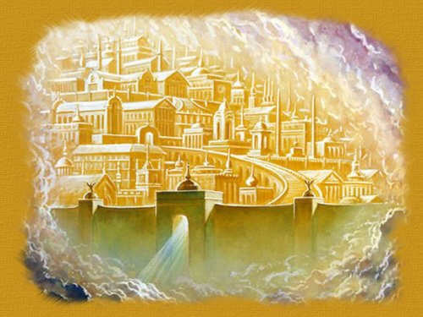
Millennium
New Heaven and new earth (Rev 21:1)
New Jerusalem (v.2)
River of water of life (22:1)
Tree of life with eternal fruit
(v.2)
Curse is gone (v.3)
Bride of Christ dwells with the Lamb
No longer death, mourning, crying or pain

Slide 27
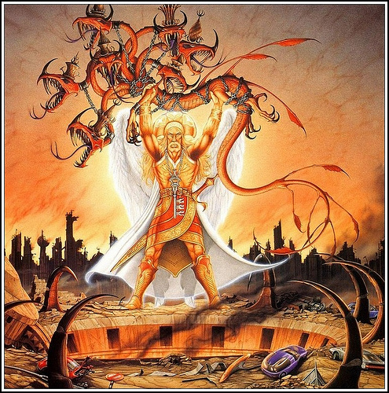
Five “And I saw…” Phrases Rev 20,21
Satan is bound – forces totally destroyed but Satan is alive – Rev 20:2-3

Slide 28
Five “And I saw…” Phrases Rev 20,21
Sheep and Goat Judgment – eliminate all Gentile children of wrath who survived day of the Lord (Eph 2:2) (Matt 25:31-40)
  Whether non-Jewish survivor worshipped Beast or taken mark (Rev 16:2, 14:9-11)
  Treatment of Israel (Matt 25:40)

Slide 29
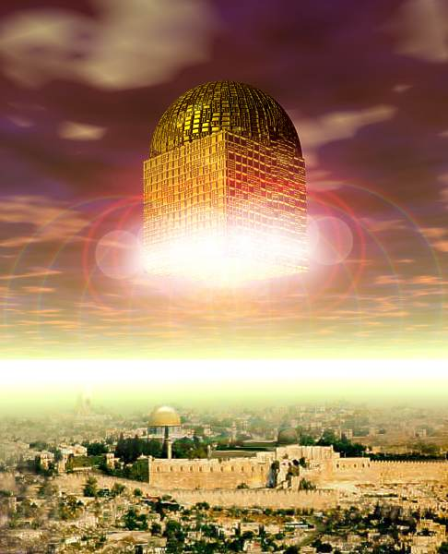
Five “And I saw…” Phrases Rev 20,21
Beheaded Martyrs Resurrected (Rev 20:4-5) – those slain because of the Word – Rev 6:9
New Heavens and New Earth
  Earth in state of devastation
  2 Pet 3:10
  Radical renovation –
  “new” is renewed

Slide 30

Five “And I saw…” Phrases Rev 20,21
New Jerusalem Rev 21:1-7
  Heavenly mansions will
  descend from heaven
  No temple (Rev 21:22)
  New Jerusalem joins earth
  at summit of Mount Zion –
  Christ reigns from throne room in new temple, part of new Jerusalem.
  Period of harmony, justice and peace far superior to anything

Slide 31
Eternal State
Very little said in Scripture
We continue to enjoy God forever
Christ presents kingdom to Father
(1 Cor 15:24-28)

Slide 32
Now What???
Why do you think this was in the Bible?
What do you do with this information?
How can you apply it in your life?
What are the Bible books you can study?
Caution… there is a lot of bad info out there!
Revelationcommentary.org
Solagroup.org
Awordfromtheword.org

