Slide 1
CHURCH HISTORY SURVEY

Slide 2
Introduction
Church history seems irrelevant to the 21st Century
Christianity is deeply rooted in history
God came to earth as a man 2000 years ago
Historical reality of sacrifice, death, burial and resurrection is cornerstone
Church history is to see the hand of God at work in the life of man

Slide 3
Value of History
Much to learn between time of apostles and today
1 Cor 10: 1-13 teaches us to learn from the past
Many who are skeptical associate violence of imperialism and crusades.
  History shows this time was during papacy as political institution
  Crusades used Christianity, but had nothing to do with gospel of grace.
Many new ideas of religious philosophy presented under guise of Christianity
Nothing new – similar to Arianism, Gnosticism and more.
Must separate fads from facts

Slide 4
8 Great Ages of the Church
(30-70) The Time of Jesus and the Apostles
(70-312) The Age of Catholic Christianity
(312-590) The Age of the Christian Empire
(590-1517) The Middle Ages
(1517-1648) The Age of Reformation
(1648-1789) The Age of Reason and Revival
(1789-1914) The Age of Progress
(1912-current) The Age of Ideologies

Slide 5
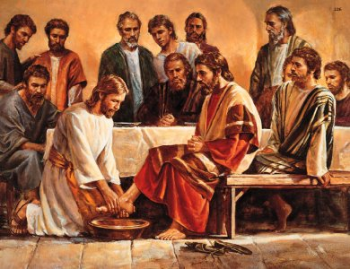
(30-70 AD) The Time of Jesus and the Apostles
The death and resurrection of Christ.
The Christian faith is birthed and the gospel of grace is preached.

Slide 6
What Happened to the Disciples?
PAUL
After the initial journeys mentioned in Acts, some think that he later went to Spain on a fourth missionary journey, as he had hoped to do. The Roman Emperor Nero is said to have had Paul beheaded in Rome around 66 AD.

Slide 7
What Happened to the Disciples?
ANDREW
Traveling to what is now modern-day Russia, to the "land of the man-eaters," Andrew preached Jesus to its inhabitants. Christians there claim that he was the first to bring them the gospel. It is also said that he preached in the Roman province of Asia (modern-day Turkey). Tradition also has him preaching in Greece, and says that he was crucified there.

Slide 8
What Happened to the Disciples?
BARTHOLOMEW
Tradition says that he went on missionary journeys to Southern Arabia and Ethiopia. He accompanied Thomas as he traveled to India, and also he preached in Armenia. Accounts of his death vary, but all agree that he was martyred for the faith.

Slide 9
What Happened to the Disciples?
JAMES, THE SON OF ALPHEUS
James, the Son of Alpheus, is said to have proclaimed Jesus in Syria. Josephus (a Jewish historian) reported that he was stoned and then clubbed to death.

Slide 10
What Happened to the Disciples?
JOHN
The only Apostle for certain never said to have been martyred, is the Apostle John. John became Bishop of Ephesus (a Greek City located in what is now modern-day Turkey). He was exiled to the Island of Patmos. There John was inspired by God to write the Book of Revelation. Tradition holds that this happened in a particular cave which you can still go and visit. Greek Orthodox Monks long ago built a Church and monastery over it.

Slide 11
What Happened to the Disciples?
MATTHEW
Matthew (Levi) was the tax collector who followed Jesus and later wrote the Gospel of Matthew. He preached in Persia and Ethiopia. Sources hold that Ethiopia was the place where he died; and that he was stabbed to death there.

Slide 12
What Happened to the Disciples?
MATTHIAS
The other Apostles chose Matthias to take the place of Judas in an attempt to fulfill the Old Testament prophecy "...let another take his office" quoted in Acts 1:20. Matthias is never mentioned again in Scripture. Tradition says that Matthias traveled to Syria with Andrew and was burned to death

Slide 13
What Happened to the Disciples?
PETER
It is said that Peter asked to be crucified upside down in Rome, saying that he was not worthy to die in the same manner as his Lord. He was executed in 66 A.D. by the Roman Emperor Nero.

Slide 14
What Happened to the Disciples?
PHILIP
Philip is said to have brought the Gospel to the north African city of Carthage. It is also said that he led the wife of a Roman proconsul to the Lord, and that the proconsul was not pleased with this. It is said that he had Philip arrested, and executed with great cruelty.

Slide 15
What Happened to the Disciples?
SIMON THE ZEALOT
Simon traveled to Persia. Tradition says that he refused to sacrifice to the Persian's sun god, and was killed because of it.

Slide 16
What Happened to the Disciples?
THOMAS
It is held that Thomas preached east of Syria. Tradition says that he proclaimed Christ in India, and founded the church of Mar Thoma. This church is still in existence today, and claims Thomas as its founder. In India they say that he then traveled to China and also preached the Gospel there, later returning again to India. Thomas is said to have died in India, killed by four soldiers armed with spears.

Slide 17
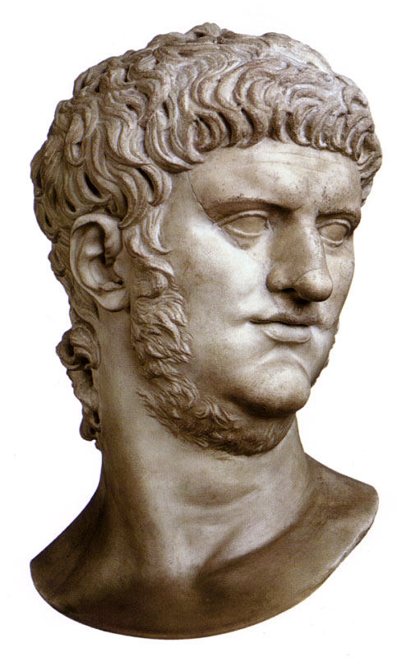
(30-70 AD) The Time of Jesus and the Apostles
64 – Emperor Nero blames fire that destroys Rome on Christians.
Begins a ruthless persecution
of Christians, using them as
candles to light his garden.

Slide 18
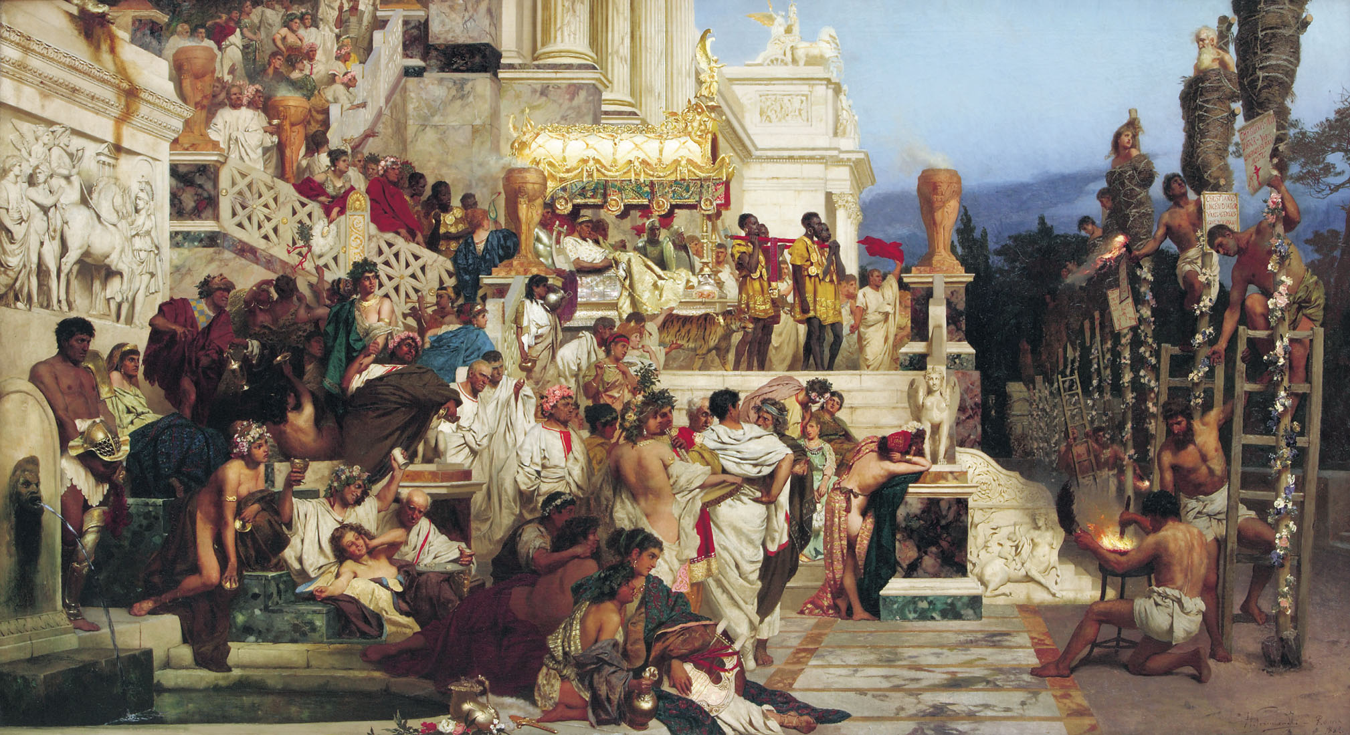
Henryk Siemiradzki (1843 –1902)

Slide 19
(30-70 AD) The Time of Jesus and the Apostles
69 – Polycarp defends the faith in Asia Minor (Turkey) combating various splinter religions (Marcionites and Valentinians)
  Disciple of Apostle John
  Bishop of Church at Smyrna
  Persecution in Smyrna resulted in Believers being fed to wild beasts
  Polycarp had fled but was found by authorities
  Welcomed captors as friends and offered them food and drink.
  Requested that he could pray for an hour before arrest

Slide 20
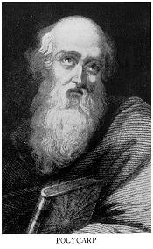
Polycarp
  When brought to the arena, Proconsul pled with him “Curse Christ and I will release you”
  Reply “86 years I have served Him. He has never done me wrong. How then can I blaspheme my King who has saved me?”
  Proconsul: “Just swear by the genius of the emperor” (“spirit” or god-ness of emperor)
  Reply “I am a Christian.”
  Proconsul “I will have you burned alive”
  Polycarp “You threaten fire that burns for an hour and is over. But the judgment on the ungodly is forever.”

Slide 21
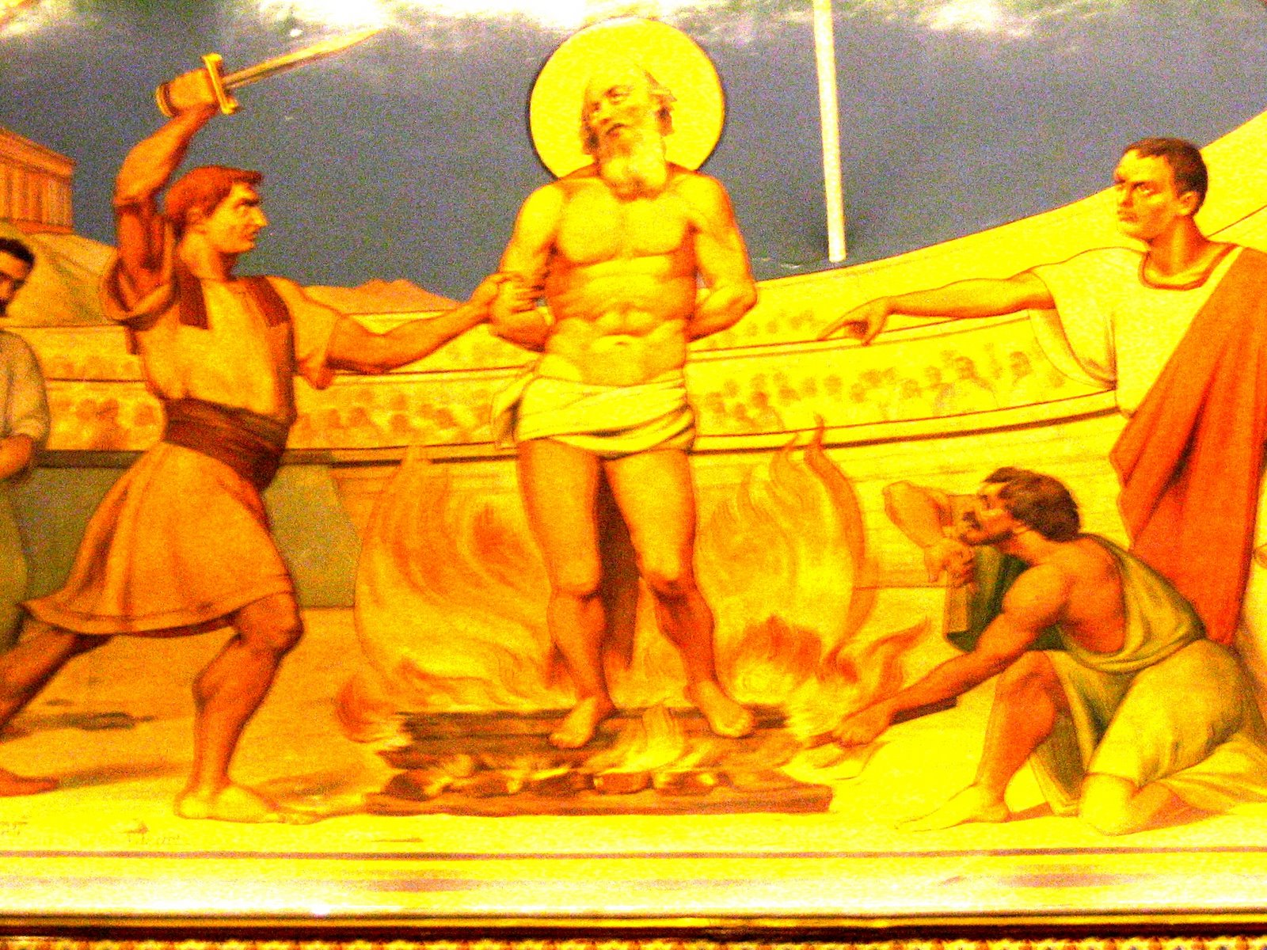

Slide 22
(70-312) The Age of Catholic Christianity
The spread of the Christian faith;
Martyrdom of the early believers.
Early heresies sprouted
First church councils and the canonizing of scripture.

Slide 23
(70-312) The Age of Catholic Christianity
70 – 73 - Roman General Titus captures Jerusalem and destroys the Jewish Temple
  Forbids Jews to live in Jerusalem, renaming Judea “Syria Palestine”
  Many Jews are enslaved and sold in Egypt.
  Many more forced to move throughout Roman Empire (Jewish Diaspora)

Slide 24
(70-312) The Age of Catholic Christianity
90 – John completes last book of the Bible – Revelation
96 – Trajan becomes Emperor
  Eventually institutes new policy toward Christians – not to seek them out but if brought before authorities they were to be punished, usually executed.

Slide 25
(70-312) The Age of Catholic Christianity
107 – Ignatius of Antioch fed to the Lions in Rome
  Ignatius was student of John the Evangelist and friend of Polycarp.
  Wrote 7 letters that helped solidify the beliefs of the church
  Church can only preserve unity if each member fulfills his role as a Christian in the world.
  Widely known throughout the Christian world.
  Had to beg wealthy Christians not to prevent his martyrdom.

Slide 26
(70-312) The Age of Catholic Christianity
161 – Marcus Aurelius becomes Emperor
  Abandons Trajan’s approach and actively seeks out Christians for persecution.
271 – Antony (Anthony) First Monk
  Converted to Christ at 20 years old and moves to Egyptian desert after hearing “If thou wilt be perfect, go and sell all that thou hast.”
  Intentionally lived the solitary life devoted to God.
  Hundreds followed him

Slide 27
(312-590) The Age of the Christian Empire
Constantine declares Christianity the official religion of the Roman Empire
Age of great councils.
Christianity became a faith for the masses;
Start of Monasticism.

Slide 28
(312-590) The Age of the Christian Empire
312 – Constantine defeats Maxentius at battle of Milvian Bridge
  Last great persecutor of church, Diocletian, had appointed co-rulers
  After he retired, there was a scramble for power
  Constantine was a son of one of the co-rulers.
  He marched troops to battle another would-be ruler, Maxentius
  Constantine’s father was a monotheist – did not believe in pagan gods.
  Constantine sought father’s God in prayer for how to help win the battle

Slide 29
(312-590) The Age of the Christian Empire
  He then got a vision of a cross with the words “In this sign you will win.”
  Constantine and entire army had a vision, so he accepted it as truth.
  He had the cross inscribed on his soldier’s armor and went into battle.
  Against a superior force, he won.
  Constantine made Christianity the official religion of the empire.
  Church spread more rapidly, but it became fashionable to be a Christian.
  Accommodations were made to pagan pasts of new members

Slide 30
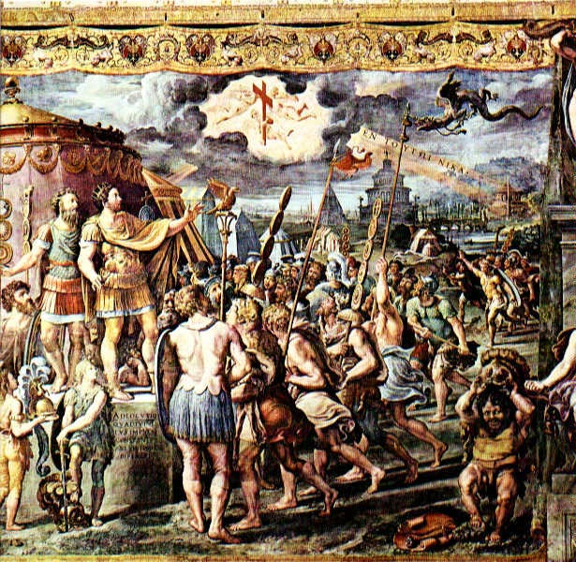

Slide 31
(312-590) The Age of the Christian Empire
320 – First History of the Church Written
  Bishop Eusebius of Caesarea was a learned scholar
  Quotes many sources including Jewish and Roman Historians like Josephus, Tacitus, Polycarp, Irenaus and others
  Interesting what is not mentioned in the history:
    Bishop in Rome has no authority outside of Rome
    No Icons used
    No prayers to Mary or to the Saints

Slide 32
(312-590) The Age of the Christian Empire
325 – Council of Nicea – checked heresy and defined doctrine
  Three hundred twelve Bishops gathered and attempted to describe exactly who Jesus was.
  Developed Nicean Creed which declared Jesus to be God
  Also affirm which books are divinely inspired (Canon of Scripture of NT)

Slide 33
Nicean Creed (portion)
We believe in one God the Father Almighty, Maker of all things visible and invisible; and in one Lord Jesus Christ, the only begotten of the Father, God of God, light of light, true God of true God, begotten not made, of the same substance with the Father, through whom all things were made both in heaven and on earth; who for us men and our salvation descended, was incarnate, and was made man, suffered and rose again the third day, ascended into heaven and cometh to judge the living and the dead…

Slide 34
(312-590) The Age of the Christian Empire
354 – Augustine born
  Know of his life because he writes first autobiography in history – “Confessions” in 390
  Born in North Africa, lived a lustful life, educated in Carthage
  Becomes professor seeking all types of intellect and reason
  Moved to Rome to pursue education and pleasures
  Began attending Bishop Ambrose’s church and liked his eloquence
  Intellect prevented full acceptance of the Gospel, but he began reading Bible.

Slide 35
Augustine (Cont.)
  Reading Romans, became “soundly saved”
  Returned to Africa, became priest, then Bishop of Hippo
  Preached 5 days in a row, sometimes twice a day
  Wrote over 1000 treatises on Christianity.
  Luther and Calvin drew heavily on his work, as well as both Protestants and Catholics.
  Considered one of the most influential Christians to have lived.

Slide 36
(312-590) The Age of the Christian Empire
429 – Telemachus responsible for ending Coliseum Games
  While visiting Rome, he places himself between two gladiators
  Crowd became enraged and stoned him to death
  Emperor Honorius declares Telemacus to be a victorious martyr and ends Gladitorial and Coliseum Games forever.

Slide 37
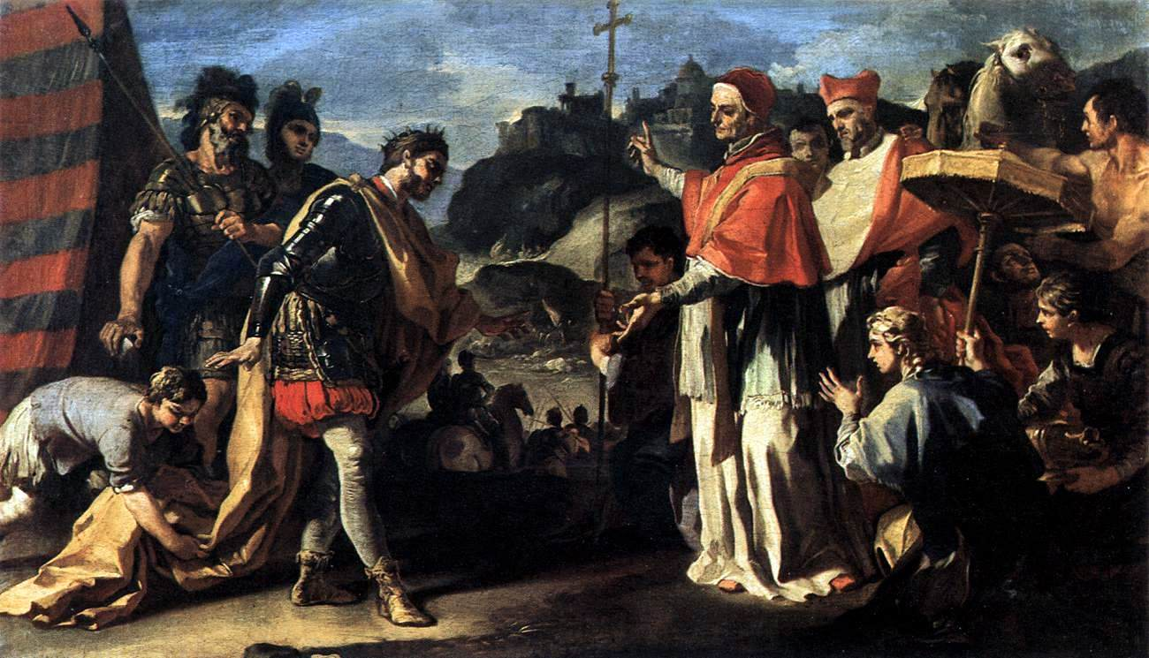
(312-590) The Age of the Christian Empire
461 – Leo I (Leo the Great) is Bishop of Rome and claims authority over all Christians.
  Largely ignored for the next 200 years, but sets the stage for the schism between Eastern and Roman
  churches.

Slide 38
(590-1517) The Middle Ages
The fall of Rome and the Byzantine Empire.
Benedictine monks deployed as missionaries
The pope becomes the "ruler" of the church.
The crusades: The church gains the world but looses it soul.

Slide 39
(590-1517) The Middle Ages
622 – Mohammed is forced out of Mecca and begins Islam
1054 – Patriarch of Constantinople closes the Roman Catholic churches in his jurisdiction.
  Bishop of Rome excommunicates the Patriarch, causing the eastern church to reject the claims of the authority of Rome

Slide 40
(590-1517) The Middle Ages
1095 -1272 Crusades – Religious conflicts under the symbol of the cross
  Conducted by Catholic Europe against Muslims, pagans and heretics.
  Fought in the Near East, North Africa, Eastern and Northern Europe
  Campaigns to the Holy Land to establish control over religious sites, economic advancement and political control

Slide 41
(590-1517) The Middle Ages
  Soldiers became Crusaders by taking vows, for which the papacy granted plenary indulgence (remission of punishment from sin in purgatory)
  7 Major Crusades against Muslim territories along with several minor Crusades
  Criticized because caused survivors to be more embittered against the Christian faith.
  Many remarked about the loss of high ideals in favor of cruelty and greed.

Slide 42
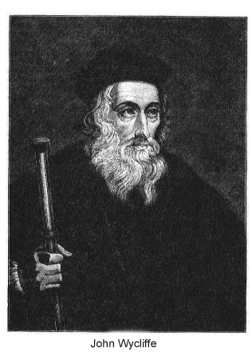
(590-1517) The Middle Ages
1382 – John Wycliffe
translates the first
Bible into English
  Spoke about the errors of
  the Popes, the hierarchy
  of the Roman Church and
  the corruption of the clergy
  Popular with the people,
  but not with the Religious
  leaders

Slide 43
(590-1517) The Middle Ages
1414 – John Hus, a Roman Catholic Priest, was translating Wycliffe Sermons
  Became convinced that Christ, not Peter, was the foundation of the Church
  Began the Protestant movement
  Was imprisoned and burned at the stake
1507 – Martin Luther is ordained a Priest
1509 – Henry VIII becomes King of England

Slide 44
(590-1517) The Middle Ages
1509 – John Calvin is born
1510 – Martin Luther realizes corruption of the church
1516 – Erasmus publishes two major works
  Praise of Folly, poking fun at errors of Christian Europe
  Greek New Testament – correcting many errors from the Latin Vulgate.
  Also, he included over 1000 notes pointing out common errors in interpretation. (ie, attacking Rome’s refusal to let priests marry)
  His work helped to bring about the Reformation.

Slide 45
(1517-1648) The Age of Reformation
Martin Luther and the protestant movement.
The start of denominationalism - Examples: Lutheran, Reformed, Anabaptist and Anglican.
The papacy looses it power and influence

Slide 46
(1517-1648) The Age of Reformation
1517 – Pope Leo X offers indulgences for sale to rebuild St. Peter’s.
  The indulgence absolved people from all sin, past, present and future, restoring complete innocence until death.
  This got the attention of Martin Luther

Slide 47
(1517-1648) The Age of Reformation
1517 – Martin Luther nailed a challenge to debate on the church door in Wittenberg, Germany.
  Later called the “95 Theses”, it was to be the official start of the Protestant Reformation
  He heard the jingle “As soon as the coin in the coffer rings, the soul from purgatory springs.”
  Believed he needed to teach salvation by Christ’s work alone.

Slide 48
Martin Luther (cont)
  Pope condemned Luther and his views, Luther burned the decree.
  In 1519, he published a denial of papal primacy and infallibility of church councils.
  In 1520 he published three books denying papal celibacy and advocated baptism and communion as the only two sacriments.
  Opposed division between clergy and laity
  Promoted the sufficiency and authority of the Scriptures.

Slide 49
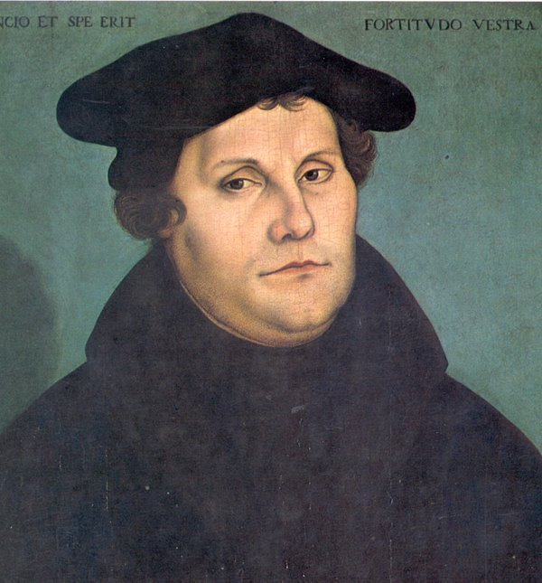
Martin Luther

Slide 50
(1517-1648) The Age of Reformation
1525 – William Tyndale translates Bible into English and smuggles copies into England
  Bibles were against the law as were prayers in English
  Agents found Tyndale and strangled and burned him at the stake in Belgium in 1536

Slide 51
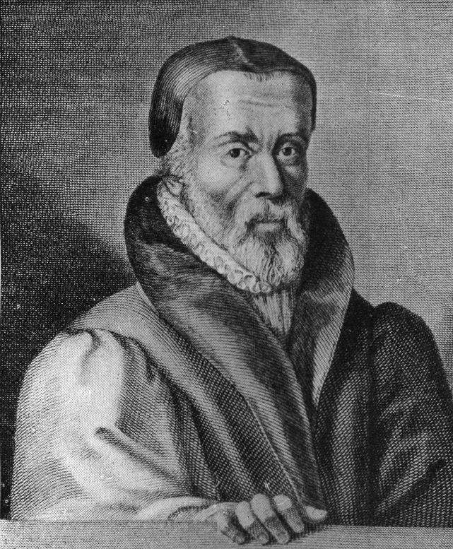
William Tyndale

Slide 52
(1517-1648) The Age of Reformation
1536 – John Calvin publishes The Institutes of the Christian Religion
  John lived and worked in Geneva, Switzerland
  Pastored St Pierre church, preaching daily
  Produced dozens of commentaries on every book of the Bible
  Wrote devotionals and doctrinal pamphlets
  Taught John Knox who would move to Scotland and start the Presbyterian denomination
  Major teaching – God is soverign

Slide 53
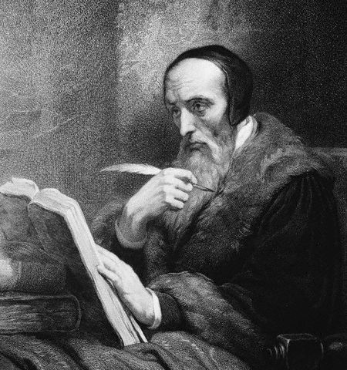
John Calvin

Slide 54
(1517-1648) The Age of Reformation
1537 – King Henry VIII declared Bible legal to be read and possessed in English
1603 – Jacobus Arminius appointed Professor of Theology at Leiden University
  Believed that Romans 7 referred to unregenerate person, not regenerate
  Taught against the Calvinist view of predestination
  People have genuine free will and grace is resistible
  God predestined those He knew would obey him

Slide 55
(1517-1648) The Age of Reformation
1608 – John Smith teaches adult baptism in England, leading to formation of the Baptist church
1611 – King James Bible published
  James VI from Scotland becomes King after Elizabeth’s death
  Desired a more accurate translation of the Bible
  Appointed 50 of the finest language scholars
  No marginal notes
  Wanted a popular translation that could be read in Church.

Slide 56
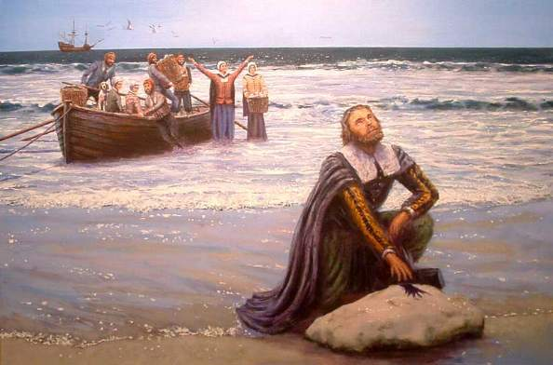
(1517-1648) The Age of Reformation
1620 – Pilgrims sailed to New England and establish a Christian community

Slide 57
(1648-1789) The Age of Reason and Revival
Secularism -- The mind becomes god
People begin to ask, "Who needs God?"
Revivals such as Pietism, Methodism and the Great Awakening seek to restore God to public life.

Slide 58
(1648-1789) The Age of Reason and Revival
1678 – John Bunyan publishes Pilgrim’s Progress, second best-selling book of all time
  Read Luther’s commentary on Galatians and realized he could be justified by faith alone.
  Became a preacher, but open air preaching was a crime.
  Put in prison without trial, and elected to stay after the judge told him he could be released if he would stop preaching.

Slide 59
(1648-1789) The Age of Reason and Revival
  Stayed in prison for over 12 years. Sang, read his Bible and wrote the entire time.
  Wrote 60 books
  Hugely popular with the people who would come to see him and hear him speak.
  He was released from time to time by his jailer so that he could attend meetings.

Slide 60
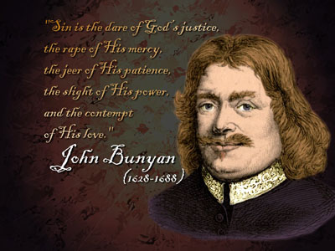

Slide 61
(1648-1789) The Age of Reason and Revival
1738 – John Wesley becomes a Christian
  Desire to bring the Gospel into daily lives of alienated masses
  Led a revival in England called “the Great Awakening”
  Started fellowship, accountability and Bible study groups
  Started Sunday school classes
  Started the Methodist movement in 1784 in America.

Slide 62
(1648-1789) The Age of Reason and Revival
1755 – German philosopher Emmanuel Kant appointed lecturer at Konigsberg
  Believed mind can only know what it experiences
  Denied work and intention of God in the lives of humans
  “We do not have the slightest ground to assume the object of this idea”
  “Religion exists, but there is no evidence of supernatural or transcendent belief”
  Value in living by the moral code of Christianity, but no truth to it’s essence.

Slide 63
(1789-1914) The Age of Progress
The message of Christ is carried to distant lands
Faith continues to leave public life.
Pluralistic (all needs are met – no rights or wrongs) and totalitarian (no limits to authority of state) societies see no relevance for Christianity

Slide 64
(1789-1914) The Age of Progress
1793 – William Carey goes to India as a missionary – starting the foreign missions movement.
  After 6 years without a convert, begins Bible translations and completes more translations than had been made in the entire history of Christianity.
1809 – Harvard University, founded in 1636 by Puritans, falls to Unitarianism (no trinity)

Slide 65
(1789-1914) The Age of Progress
1841 – David Livingstone goes to Africa to evangelize the country for 30 years.
1856 – First service at Surrey Gardens for Charles Spurgeon with 12,000 people attending
  Spurgeon had begun preaching years before in various venues
  Completed his own church in 1861 – Metropolitan Tabernacle
  Direct style of speech, passion for truth.
  Hailed as the most prolific preacher in history.

Slide 66
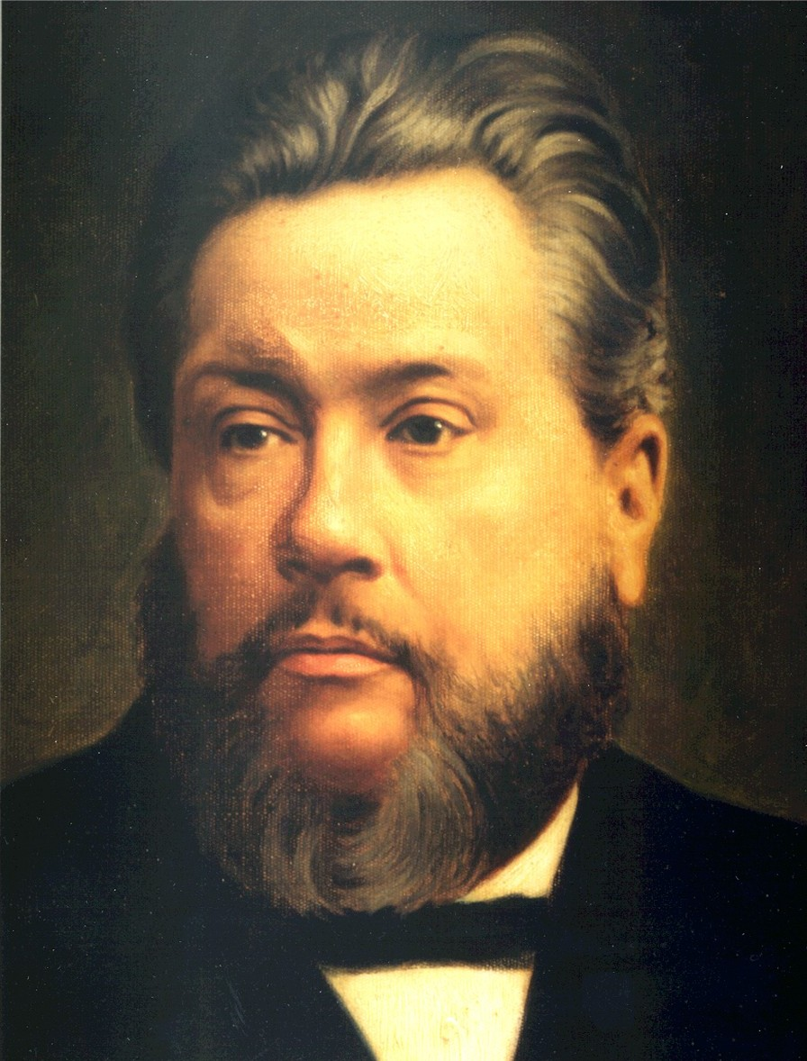

Slide 67
(1789-1914) The Age of Progress
1865 – J. Hudson Taylor founds China Inland Mission
  849 Missionaries, 205 stations, 125,000 Christians
1886 – Moody Bible Institute founded by Dwight L. Moody
1901 – Pentecostal Movement started at Bethel Bible College

Slide 68
(1912-current) The Age of Ideologies
1914 – Assemblies of God founded
1929 – Westminster Seminary is founded after Princeton is lost to liberals
1948 – Israel becomes a nation
  First time since destruction of Temple by Roman General Titus in 70 A.D.
  Return of Jewish people to Israel escalates

Slide 69
(1912-current) The Age of Ideologies
1950 – Billy Graham founds Billy Graham Evangelistic Association.
  Preaches the Gospel in person to more people than any other man in the history of the world.
1950 – The Lion, the Witch and the Wardrobe written by C.S. Lewis
1965 – Start of Jesus Abbey in Korea
  Dedicated to intercessory prayer and returning to lifestyle of early Christians

Slide 70
(1912-current) The Age of Ideologies
1967 – Ancient city of Jerusalem regained by Jewish people after Six-Day War
1968 – Liberation Theology introduced
1969 – Charismatic Movement begins in mainstream denominations

Slide 71
(1912-current) The Age of Ideologies
2000 – Report that Christianity is increasing in Africa
  9% in 1900 to 45% in 2000
  Great persecution but also great growth
  1.8 million martyrs in 20th century
  Largely due to indigenous leadership

Slide 72
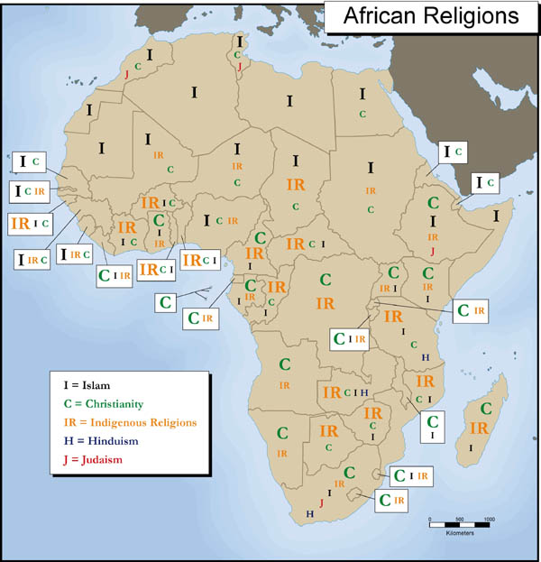

Slide 73
(1912-current) The Age of Ideologies
2006 – Popularity of The Da Vinci Code is an attack on Jesus and Scripture
  Raise question and doubts on Christian teaching
  Uninformed Christians eager for “new information”
  3 major assertions from Da Vinci Code:

Slide 74
1. Christians did not view Christ as divine
…the truth lived out in the lives of the early Christians and expressed through the writings of their leaders is the exact opposite of the argument made in The Da Vinci Code. Evidence shows that the vast majority of early Christians believed Jesus was no mere mortal prophet. In fact, the debate at Nicea was not whether Jesus was human or God; it was over exactly how divine He was.

Slide 75
2. Constantine suppressed true gospels for power
In Egypt before A.D. 254, scholar and teacher Origen accepted only the four gospels. Origen traveled extensively, noting which scriptures were read in various regions. Sometime between A.D. 244 and 254, he wrote that Matthew, Mark, Luke and John "are the only indisputable ones in the church of God under heaven. . .we have approved solely what the church has recognized, which is that only the four Gospels should be accepted."

Slide 76
3. Church covered up fact that Jesus and Mary had a child
There is no historical evidence that Jesus was ever married or had children. But even if He had, there would be no theological reason to hide it. The council of Nicea, which Brown's characters claim invented Christ's divinity, is the very one that also pointed out his humanity.

Slide 77
Conclusion
Many of the attacks on our faith are based on attacks on our history
New Religions and accusations fail to realize that our history is rich
Church is marked with times of persecution and times of prosperity.
Faith is important but we are not left with faith alone
We know the final chapter and must be prepared

Slide 78
Resources for further study
The Early Church Fathers By Hendrickson Publishers
Augustine of Hippo: A Biography by Peter Brown
Church History in Plain Language by Bruce Shelley
Christian History Timeline produced by Christianity Today International

