Slide 1
Making Disciples
Near and Far
Foundations

Slide 2
“Disciple” Defined:
A person who is a pupil or an adherent of the doctrines of another
To teach or train another
A disciple of Christ is one who (1) believes his doctrine, (2) rests on his sacrifice, (3) imbibes his spirit, and (4) imitates his example (Matt. 10:24; Luke 14:26, 27, 33)

Slide 3

Engage Your World
In your “Going” make disciples
where you live, work, and play.

Slide 4
Goal: to create a disciple making movement that produces churches that are Biblically driven, culturally relevant, missional communities who seek to transform the lives of those around them.

Slide 5
Disciple making is about Reproduction
Disciples – Leaders – Churches
We want to make Disciples who become Leaders who help make more Disciples.
This process eventually leads to Establishing Churches near and far as leaders are sent out to reproduce this disciple making process in other cities, contexts, and cultures.

Slide 6
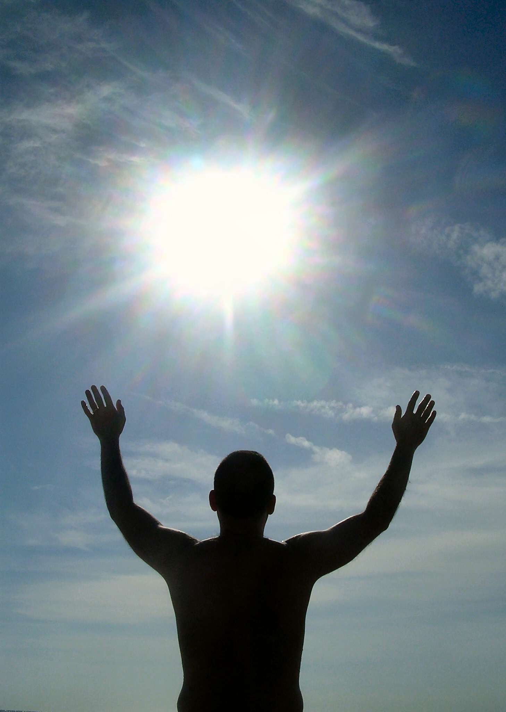
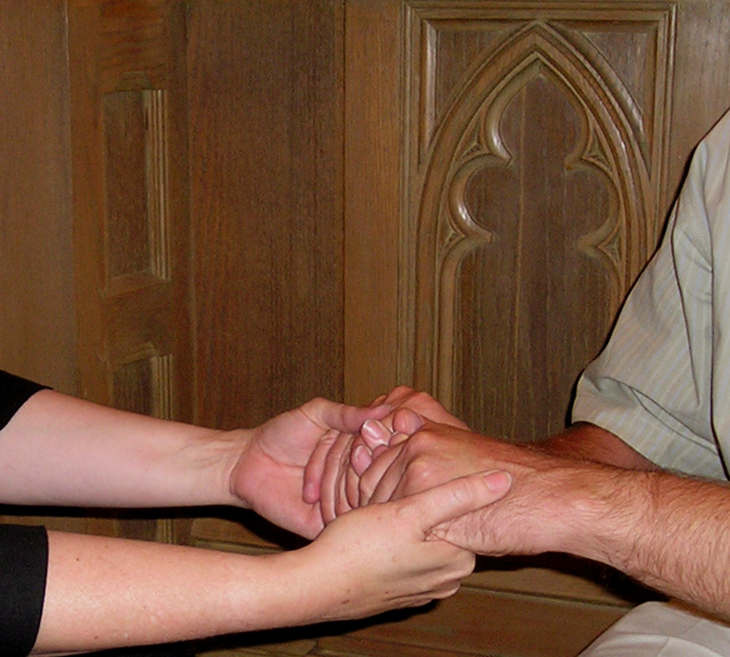
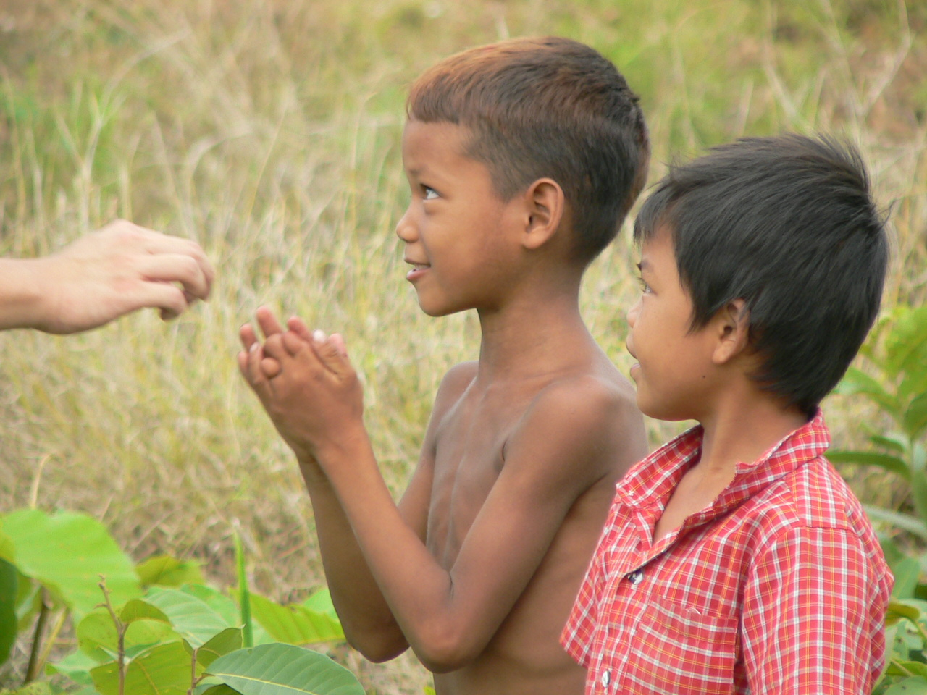
A Disciple is someone who
Loves God
Loves People
Serves the world

Slide 7
Love God:
Include God in everything.
Obey His commands.
Study His words.
Three aspects of the Christian life:
  Live simply,
  Work diligently,
  Give generously.

Slide 8
Love People:
Serve each other.
Forgive each other.
Build each other up.
Teach each other.

Slide 9
Serve the World:
Share God's love with our circle of influence.
Help those in need – the poor and defenseless.
Pray for others.
Establish churches that love God, love people, and serve the world.

Slide 10
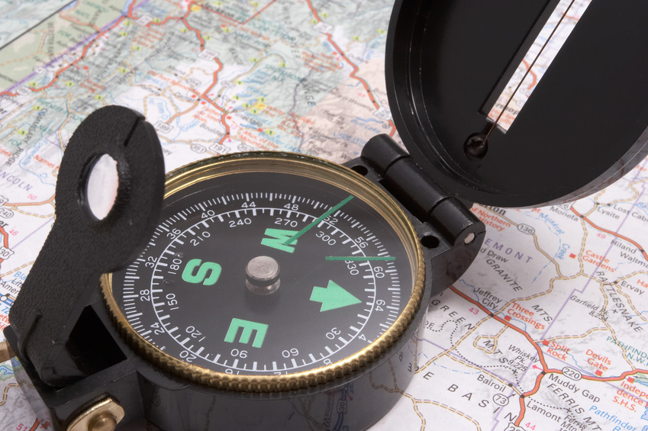
How Do We Do This?
Be Equipped
Desire
Act

Slide 11
The Call to be Sent Out
Expanding the boundaries of our Discipleship Making Movement by sending leaders out to preach the gospel and make disciples in other cities, among other cultures, and in other countries.
Key elements of Matthew 28:

Slide 12
Matthew 28:18-20
Then Jesus came to them and said, "All authority in heaven and on earth has been given to me. Therefore go and make disciples of all nations, baptizing them in the name of the Father and of the Son and of the Holy Spirit, and teaching them to obey everything I have commanded you. And surely I am with you always, to the very end of the age."

Slide 13
“Make Disciples”
Enter into a relationship with others that permits us to demonstrate and teach the gospel message on a personal level
Higher order of teaching than evangelism, requiring understanding of a wide range of doctrinal issues and the ability to begin to reproduce one’s faith in others
mature faith, capable of explanation and development of significant Biblical truth

Slide 14
“Baptize them”
Baptism into a fellowship of believers in a church
Establish a church into which one can be baptized so that accountability, growth and character development can be nurtured

Slide 15
“Teach them to observe…”
Daily routine of life that allows Christ to be demonstrated in each aspect of living; including work, play, family, and worship

Slide 16
Recent Trends
Short term missions
Relief and aid
While there may be some actions in each of these concepts that have value, it is best to focus on the more traditional Biblical mandate for missions stated in Matthew 28

Slide 17

Learn from the Experts

Slide 18
Main Goals Should Be:
Establish churches nationally and internationally
Teaching and equipping pastors and ministry leaders and families
Providing care and training for orphans
Conducting service trips and projects to help the needy.
Providing support to missionary families and programs involved in Biblical missions.

Slide 19
How to Prepare a Person
Within the Church
  Develop missional mindset
  Influence people in your circle
    Who are your 12? 6 Relational, 3 Influence, 3 Mentor
    Impact locally
    Impact globally (giving to missions, sponsor a child)
  Training (classes, mentoring, work experience)

Slide 20
How to Prepare a Person
Outside the Church
  Training programs
  Higher Education
  Online programs
  Other Church training
The church sends or supports, NOT a third party organization

Slide 21
Considerations for Missional Thinking
A. Where is God calling Me?
  Pray and trust God to give you clear direction
  Explore the areas your church is working in or towards in the world.
  Learn about the World and connect your passion to the needs in a particular place

Slide 22
Considerations for Missional Thinking
B. What is my role?
  How has God uniquely gifted you? Spiritual Gifts, Strengths, Professional Experience.
  Think Team – Are you a Visionary Leader or a Support Leader (Paul and Timothy)
  What Ministries have you served well in?

Slide 23
Considerations for Missional Thinking
C. What further Training would benefit me best?
  Masters Mission or other Mission Training Course
  Further Education/Seminary
  Internship at a church or ministry
Every Christian has a story. What is yours?

Slide 24
Personal Testimony
What is a personal Testimony?
  Story of salvation
  Good news in a person’s life
  When and how a person trusted Christ as savior
  The “journey”

Slide 25
Basic Testimony
What was your life like before Christ?
What happened to cause you to trust Christ?
What has your life been like after trusting Christ?

Slide 26
Jailhouse vs Solid Family
Proverbs is full of encouragement for godly parenting
Paul was certainly a “Newsflash event”

Slide 27
Be Prepared
Short or long (elevator testimonies)
Written testimonies for jobs or Christian ministry applications
Consider the experience of the audience (bikers, drinkers, sports, military, Christians…)
How much detail is determined by audience and time
Practice! Practice! Practice!

Slide 28
Practical Exercise
Write it out
Share it
Homework: Practice it

