Slide 1
New Testament Overview
Geography and Structure
Foundations

Slide 2
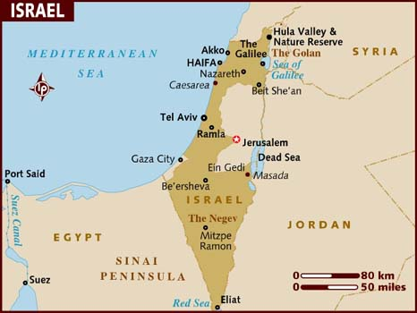

Slide 3
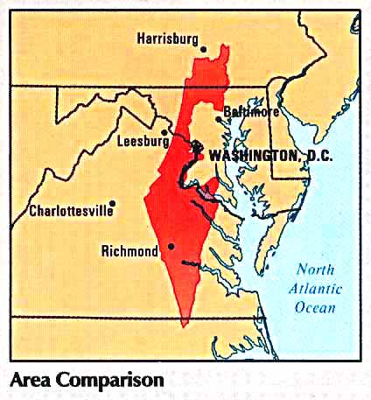
Geography of Gospels
Distance from Baltimore to Philadelphia
Desert to High Mountain
Any body of water you can’t swim = SEA
Any hill higher than your head = MOUNTAIN
Sea of Galilee 7x14 miles
Dead Sea – 10x50 miles

Slide 4
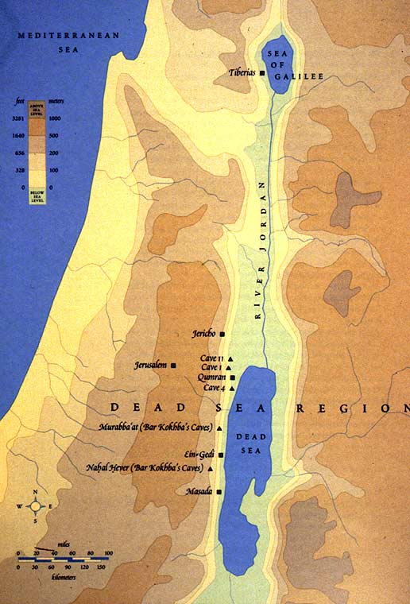
Bodies of Water
Mediterranean Sea
Sea of Galilee
Jordan River
Dead Sea

Slide 5
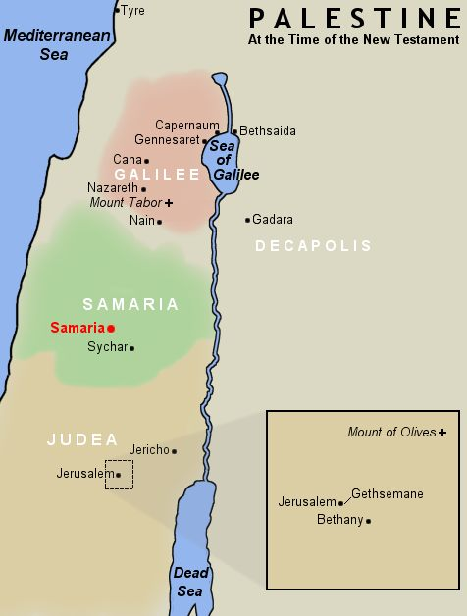
Provinces
Galilee
  Jesus considered His home province
  Nazareth and Capernaum
Samaria
  Home to Samaritans
  Jewish and Gentile – animosity
  with Jews
Judea
  Same area as southern tribe of Judah
  Home to most of the Jews in the New Testament
Perea
  Narrow province on east bank of Jordan River
  Jesus spent time here at end of His ministry

Slide 6
Cities
Nazareth
  Town where Mary and Joseph lived
Capernaum
  Top of sea of Galilee – Jesus’ home during ministry
Jerusalem
  Home of temple, holy city and center of activity
Bethlehem
  Birthplace of Jesus
  5 miles southwest of Jerusalem

Slide 7
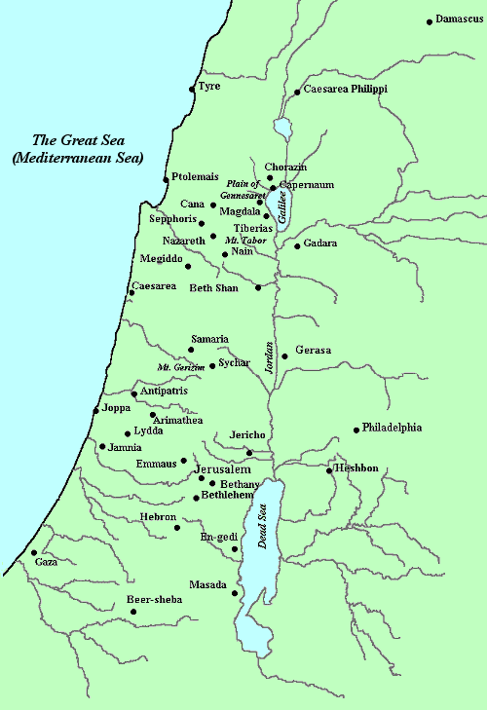
50 Miles

Slide 8
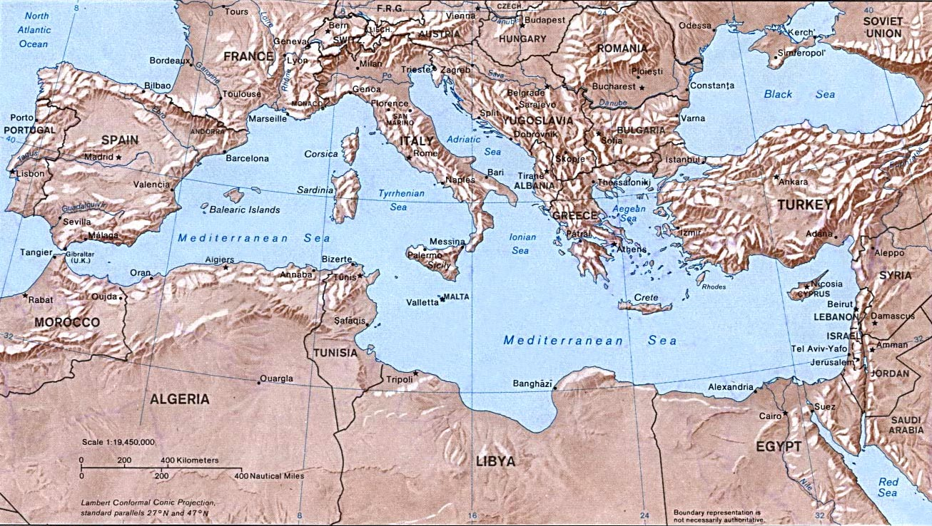
Geography of Acts –
Bodies of Water

Slide 9
Countries
Galatia
  Modern day Turkey – Paul’s first journey
Greece
  Paul’s second missionary journey
Asia
  Western coast of Turkey – Paul’s third journey
Italy
  Paul’s imprisonment and death

Slide 10
Cities
Jerusalem
  Beginning place of Christian Church
Damascus
  Paul’s destination when converted to Christianity
Caesarea
  Site of Paul’s trials
Antioch
  Start of all Paul’s missionary journeys
Rome – political and cultural heart of empire

Slide 11
Rome
Italy
Greece
Asia
Galatia
Antioch
Caesarea

Slide 12
Historical Books of the NT
Matthew - Acts
Gospels
  Life of Jesus of Nazareth
Church
  Formation of the Christian Church
Missions
  Expansion of the Church into the Roman Empire

Slide 13
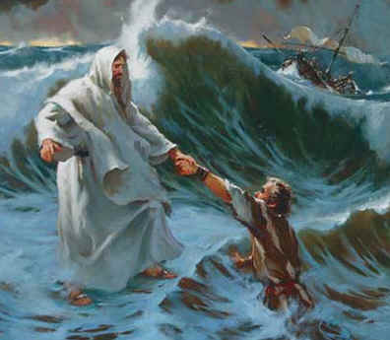
Central Figures
Jesus
  The Messiah
Peter
  Leader of the early
  Church
Paul
  The first missionary

Slide 14
Locations
Palestine
  Known as Canaan in Old Testament
  Includes Galilee, Samaria and Judea
Jerusalem
  Same location throughout history
  Birthplace of early Church
Roman Empire
  From Palestine into Turkey through Greece and Italy

Slide 15
Eras of the New Testament
Era Central Figure Location
Gospels
Church
Missions
Jesus
Peter
Paul
Palestine
Jerusalem
Roman Empire

Slide 16
Gospel Era
Matthew – John
Jesus comes in fulfillment of the Old Testament prophecies of a savior and offers salvation and the true kingdom of God. Some accept Him, most reject Him, and He is crucified, buried and resurrected.
Early Life
Early Ministry
Later Ministry
Death and Resurrection

Slide 17
Early Life
Conception by Holy Spirit
Born of the Virgin Mary in Bethlehem in Judea
Lives in Nazareth – learns trade of carpenter
Baptized at 30 years old by cousin, John
Holy Spirit descends on Him
Lead into wilderness for 40 days
Resists temptation
Ready for ministry

Slide 18
Early Ministry
Two-fold message
  That He is the Messiah (the Christ) and we should believe in Him
  Challenge people to lie a life of righteousness
Performs miracles
Signs of initial acceptance by the people
Takes place around Jerusalem

Slide 19
Later Ministry
Popularity does not last
Religious leaders jealousy – stir animosity
Focuses ministry at leaders with warnings
Sets aside time to train 12 disciples
Challenges multitude to count cost of following Him
Based primarily in Capernaum (north bank of Sea of Galilee)

Slide 20
Death and Resurrection
Jews become more polarized
During passover, leaders finally get enough support for crucifixion
Series of mock trials on false charges
Crucified on a Friday
Rises from grave on Sunday – 3 days in tomb

Slide 21
Church Era
Acts 1-12
Means chosen to carry the message of the gospel to the world. Carried by imperfect people to imperfect people to help one another grow to spiritual maturity
Creation
Growth
Persecution
Transition

Slide 22
Creation
Birthplace of church is Jerusalem
Disciples are told to wait in Jerusalem for power of the Holy Spirit, then to be witnesses to Him in Jerusalem, Judea, Samaria and throughout the world.
On the Jewish feast of Pentacost, Holy Spirit descends on disciples. (Rushing wind, fire)
Begin speaking in foreign languages so people hear their own language.

Slide 23
Growth
Organization of Church as numbers increase
Peter organizes relief effort for needy Christians
People who have possessions can sell and distribute according to needs
Deacons are chosen to look after material needs of the Church while apostles look after the spiritual needs

Slide 24
Persecution
Stephen – early preacher arrested by Jewish leaders for preaching about Jesus. Does not recant and is stoned to death.
Kicks off a round of persecution against new Christians. So severe that many flee Jerusalem.
In fleeing, they take the message of the Gospel to Judea and Samaria

Slide 25
Transition
Zealous Pharisee – Saul of Tarsus watches the coats of the people stoning Stephen.
Journeys to Damascus and Jesus appears to him. He is converted to Christianity.
Name is changed to Paul, becomes Apostle.
Told he will be a missionary to the Gentiles.
Peter is also told to take message to Gentiles.
Up to this point – message exclusively for Jews.

Slide 26
Missions Era
Acts 13-28
Paul expands the Church into the Roman Empire over the next two decades.
First Missionary Journey
Second Missionary Journey
Third Missionary Journey
Trials and Imprisonment

Slide 27
First Journey
Acts 13-14
Paul and Barnabas selected to go to Galatia.
Depart from Antioch and in Galatia for 2 years
Encouraging results from growth
After return, council is held that determines that Gentiles do not have to become Jewish in addition to becoming Christian.

Slide 28
Second Journey
Acts 15-17
Paul leaves from Antioch to visit believers from first journey.
Gets a vision from a man in Macedonia (Greece) and changes plans – goes to Greece.
Travels in Greece for three years

Slide 29
Third Journey
Acts 18-21
Paul leaves to encourage believers from first two trips and to go to Asia
Great success and great opposition
In Ephesus, city breaks out in riot over his visit
Warned that will be imprisoned on return to Jerusalem but returns anyway.
In Asia for 4 years, arrested on return

Slide 30
Trials and Imprisonment
Acts 22-28
Arrested by Jewish leaders on false charges
Moved to Caesarea, Roman capital in the area because his life was threatened
Tried under 3 men – Felix, Festus and Agrippa
Exercises right as Roman citizen to take case before Caesar in Rome.
Taken to Rome – case never comes to trial. In prison for 2 years, then beheaded.

Slide 31
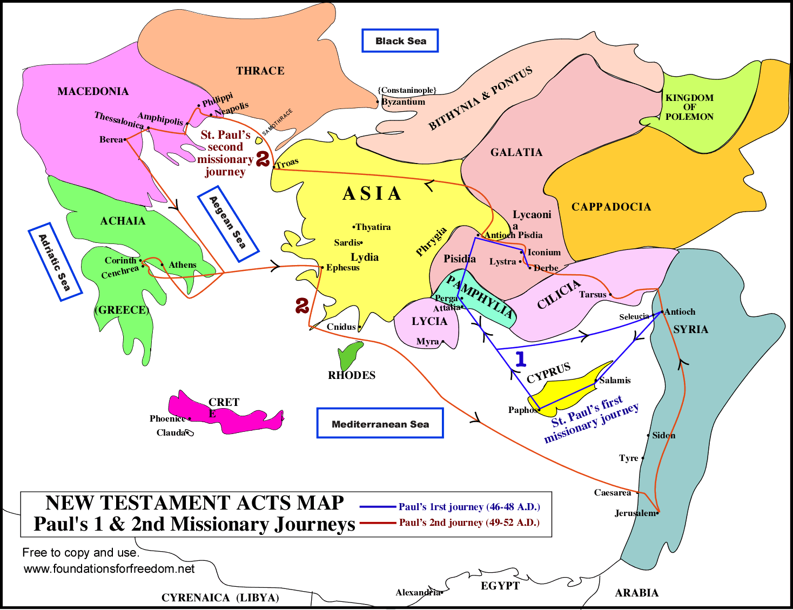

Slide 32
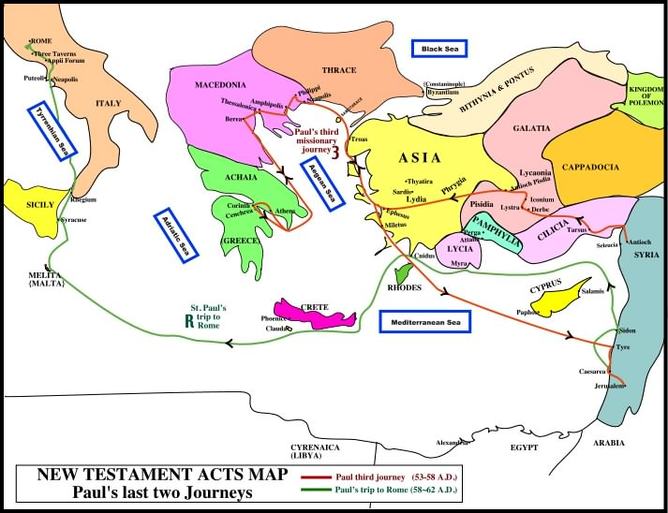

Slide 33
The Epistles
Romans - Revelation
Paul and other writers had concerns for the welfare of the people they loved. They wrote letters both to church congregations and to individuals to encourage and instruct them. These letters became the Epistles.
13 written by Paul
9 by different authors

Slide 34
Structure of New Testament
Historical
  Matthew, Mark, Luke, John, Acts
Pauline to Churches
  Romans, 1-2 Corinthians, Galatians, Ephesians, Philippians, Colossians, 1-2 Thessalonians
Pauline to Individuals
  1-2 Timothy, Titus, Philemon
General
  Hebrews, James, 1-2 Peter, 1-3 John, Jude, Revelation

Slide 35
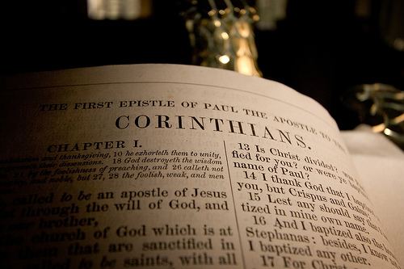
Four Main Topics in Epistles
Nature of Epistles
Pauline Epistles to Churches
Pauline Epistles to Individuals
General Epistiles

Slide 36
Nature of Epistles
Letters written to churches, individuals or general letters to the Christian public.
Deal with specific problems and issues of the day
Information is timeless and universal
Section of doctrinal truth followed by practical implications of that truth.
Doctrine, then Duty / Principle, then Practice

Slide 37
Pauline Epistles to Churches
Romans – heavily doctrinal, most complete doctrine of salvation by grace in Bible
1-2 Corinthians – heavily practical – dealing with a series of problems in the church
Galatians – written to some of Paul’s first converts refuting legalism
Ephesians – deals with believer’s position in Christ and practical implications

Slide 38
Pauline Epistles to Churches
Philippians – a warm letter of joy despite trials
Colossians – Preeminence of Christ
1-2 Thessalonians – personal letters dealing wit issues in the church including prophecy and practical living

Slide 39
Pauline Epistles to Individuals
1-2 Timothy – two letters to a young pastor in Ephesus. First counsels him on local church issues. Second encourages him to remain strong during trials.
Titus – to pastor in Crete, dealing with issues including qualifications of church leaders
Philemon – to slave owner urging lenient treatment of runaway slave who became a Christian

Slide 40
General Epistles
Hebrews – heavily doctrinal drawing from OT truth in teaching NT truth to Jews
James – incisive and practical teaching on outworking of faith in everyday life
1-2 Peter – to believers throughout Asia and Galatia, response to suffering and opposition
1-3 John – deals with love of God
Jude – warnings against ungodly living
Revelation – Nature and chronology of future

Slide 41
Practical Exercise 1
List each book in the New Testament and a brief (one-line) description of the book.

Slide 42
Practical Exercise Answer
Matthew - Presents Jesus as the Messiah. Genealogy of Jesus through Joseph. Fulfillment of O.T. prophecy.
Mark - Presents Jesus as the Servant. 1/3 of the gospel deals with the last week of His life.
Luke - Presents Jesus as the Son of Man to seek and save the lost. Genealogy of Jesus through Mary. Largest of the gospels.
John - Presents Jesus as God in flesh, the Christ, so that you might believe.
Acts - Historical account from Jesus’ ascension to travels of Paul in his missionary journeys.

Slide 43
Practical Exercise Answer
Romans - A systematic examination of justification, sanctification, and glorification. Examines God’s plan for the Jews and the Gentiles.
1 Corinthians - This letter deals with factions and corrections due to immorality, lawsuits, and abuse of the Lord’s Supper. Also mentions idols, marriage, and the resurrection.
2 Corinthians - Paul’s defense of his apostolic position.
Galatians - Paul refutes the errors of legalism and examines the proper place of grace in the Christian’s life.
Ephesians - The believer’s position in Christ and information on Spiritual warfare.
Philippians - Paul speaks of his imprisonment and his love for the Philippians. He exhorts them to godliness and warns them of legalism

Slide 44
Practical Exercise Answer
Colossians - Paul focuses on the preeminence of Jesus in creation, redemption, and godliness.
1 Thessalonians - Paul’s ministry to the Thessalonians. Teachings on purity and mention of the return of Christ.
2 Thessalonians - Corrections on the Day of the Lord.
1 Timothy - Instructions to Timothy on proper leadership and dealings with false teachers, the role of women, prayer, and requirements of elders and deacons
2 Timothy - A letter of encouragement to Timothy to be strong.
Titus - Paul left Titus in Crete to care for the churches there. Requirements for elders.
Philemon - a letter to the owner of a runaway slave. Paul appeals to Philemon to forgive Onesimus.

Slide 45
Practical Exercise Answer
Hebrews - A letter to the Hebrew Christians in danger of returning to Judaism. It demonstrates the superiority of Jesus over the O.T. system.
James - a practical exhortation of believers to live a Christian life evidencing regeneration. It urges self-examination of the evidence of the changed life.
1 Peter - Peter wrote this letter to encourage its recipients in the light of their suffering and be humble in it. Mentions baptism.
2 Peter - Deals with the person on an inward level, warnings against false teachers, and mentions the Day of the Lord.

Slide 46
Practical Exercise Answer
1 John - John describes true fellowship of the believers with other believers and with God. Describes God as light and love. Encourages a holy Christian walk before the Lord.
2 John - Praise for walking in Christ and a reminder to walk in God’s love.
3 John - John thanks Gaius for his kindness to God’s people and rebukes Diotrephes.
Jude - Exposing false teachers and uses O.T. allusions to demonstrate the judgment upon them. Contends for the faith.
Revelation – A vision of the future rebellion, judgment, and consummation of all things.

Slide 47
Practical Exercise 2
Form Two Teams
Select a spokesperson
When the question is shown, you may discuss but spokesperson must answer
1 point for every correct answer
Bonus points at the end

Slide 48
Every 50 years the Israelites had a Jubilee. What happened during Jubilee?
  Borrowed Items Were Returned
  Every servant was set free.
  No Crops Were Harvested
  All of the Above

Slide 49
When could an Israelite make a slave of another Israelite?
  One year before jubilee.
  Never
  If they were sold by a stranger.
  After Jubilee.

Slide 50
What was promised to the Israelites if they obeyed God?
  Peace
  Good Harvests
  God's Presence
  All of the Above

Slide 51
What was promised to the Israelites if they did not obey God?
  Starvation
  Plague
  War
  All of the Above

Slide 52
During the time of Moses, how much was the Tithe of the Herd?
  0.5
  0.1
  No Such Thing
  0.25

Slide 53
How much was a 20 year old male worth in Israel during the time of Moses?
  30 Shekels of Silver
  10 Shekels of Silver
  20 Shekels of Silver
  50 Shekels of Silver

Slide 54
Jesus sent his disciples out with what?
  Staves
  Scrip
  Bread and money
  Nothing
  Coats

Slide 55
What type of tree did Zacchaeus climb to see Jesus?
  Sycomore
  Gopherwood
  Cedar
  Acacia

Slide 56
How many lepers did Jesus heal, as recorded in all of the Bible?
  8
  10
  11
  14

Slide 57
What were the 12 Apostles asked to take with them as they go out to preach?
  Food For The Day
  Money For The Poor
  A Tent
  Nothing

Slide 58
Which of the following was not the name of a gate in ancient Jerusalem?
  Sheep
  Fish
  Pearl
  Dung

Slide 59
Who led the Jews in covenant renewal once the walls of Jerusalem were rebuilt after the Babylonian captivity?
  Nehemiah
  Solomon
  Samuel
  John the Baptist

Slide 60
What tribes settled east of the Jordan?
  None
  Judah & Dan
  Dan & Benjamin
  Reuben, Gad, and Manasseh

Slide 61
What is the first part of the blessing given to the people of Israel by Aaron?
  May the Lord smile on you and be gracious
  May the Lord show you His favor and give you peace
  May the Lord grant you wealth and happiness
  May the Lord bless you and keep you

Slide 62
Because of their complaining and rebellion, how long did God have the people of Israelites eat meat?
  A week
  A year
  A Month
  A Day

Slide 63
How long was Miriam banished from the camp for criticizing Moses?
  21 days
  7 days
  1 year
  30 days

Slide 64
Who did Moses send from the tribe of Judah, to scout the land of Canaan?
  Igal
  Palti
  Ammiel
  Caleb

Slide 65
What percent of the Israelites tithes were the Levites instructed to tithe to God?
  50.00%
  10.00%
  100.00%
  25.00%

Slide 66
Where was the book of 2 Timothy written?
  Jerusalem
  Rome
  Assyria
  Macedonia
  Unknown

Slide 67
In a great house there are not only vessels of gold and silver but what else?
  Wood
  Copper
  Jewels
  Wisdom
  God's holy spirit

Slide 68
Why were the cities of Antioch, Iconium and Lystra mentioned in 2 Timothy?
  Apostles experienced persecution in these cities
  Congregations in these cities were tolerating sin
  These cities were judged directly by God
  The book was written in these three cities
  They are not mentioned at all

Slide 69
According 2 Timothy 3:16 who or what is inspired by God?
  Paul
  All scripture
  Holy Ghost
  The Congregation
  Jesus Christ

Slide 70
How does this scripture end? "I have fought a good fight, I have finished my course…”
  I have overcome the world
  Let freedom ring
  Tomorrow belongs to me
  I have kept the faith
  I have seen the light.

Slide 71
This Week
Homework will be emailed tomorrow
Memory verse
Next Week – the Godhead
Drive Carefully – don’t text and drive!

